Slide 1
The Un’not’ting see also un’knot’ting creative practice with adult victims of childhood sexual abuse
Anne Riggs PhD Artist
Artists in Community International

Slide 2
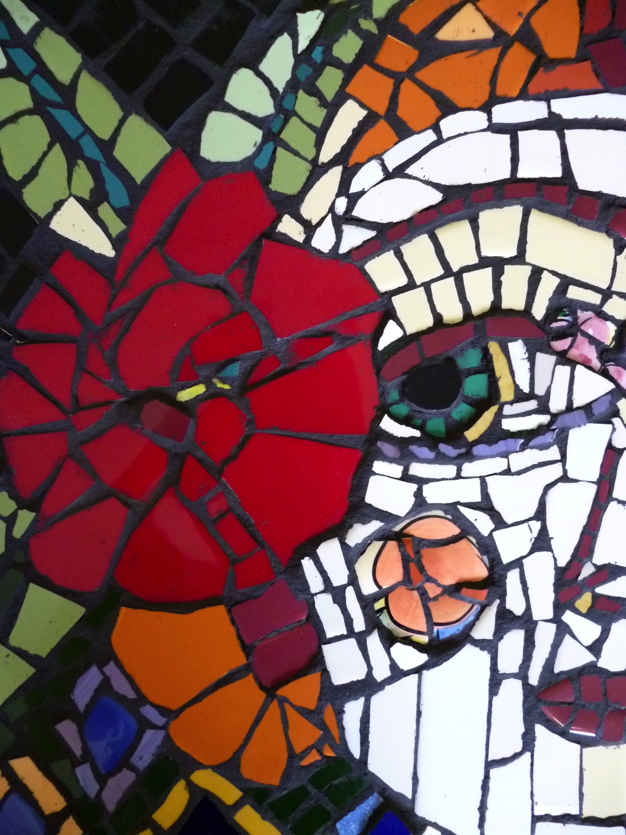

Slide 3
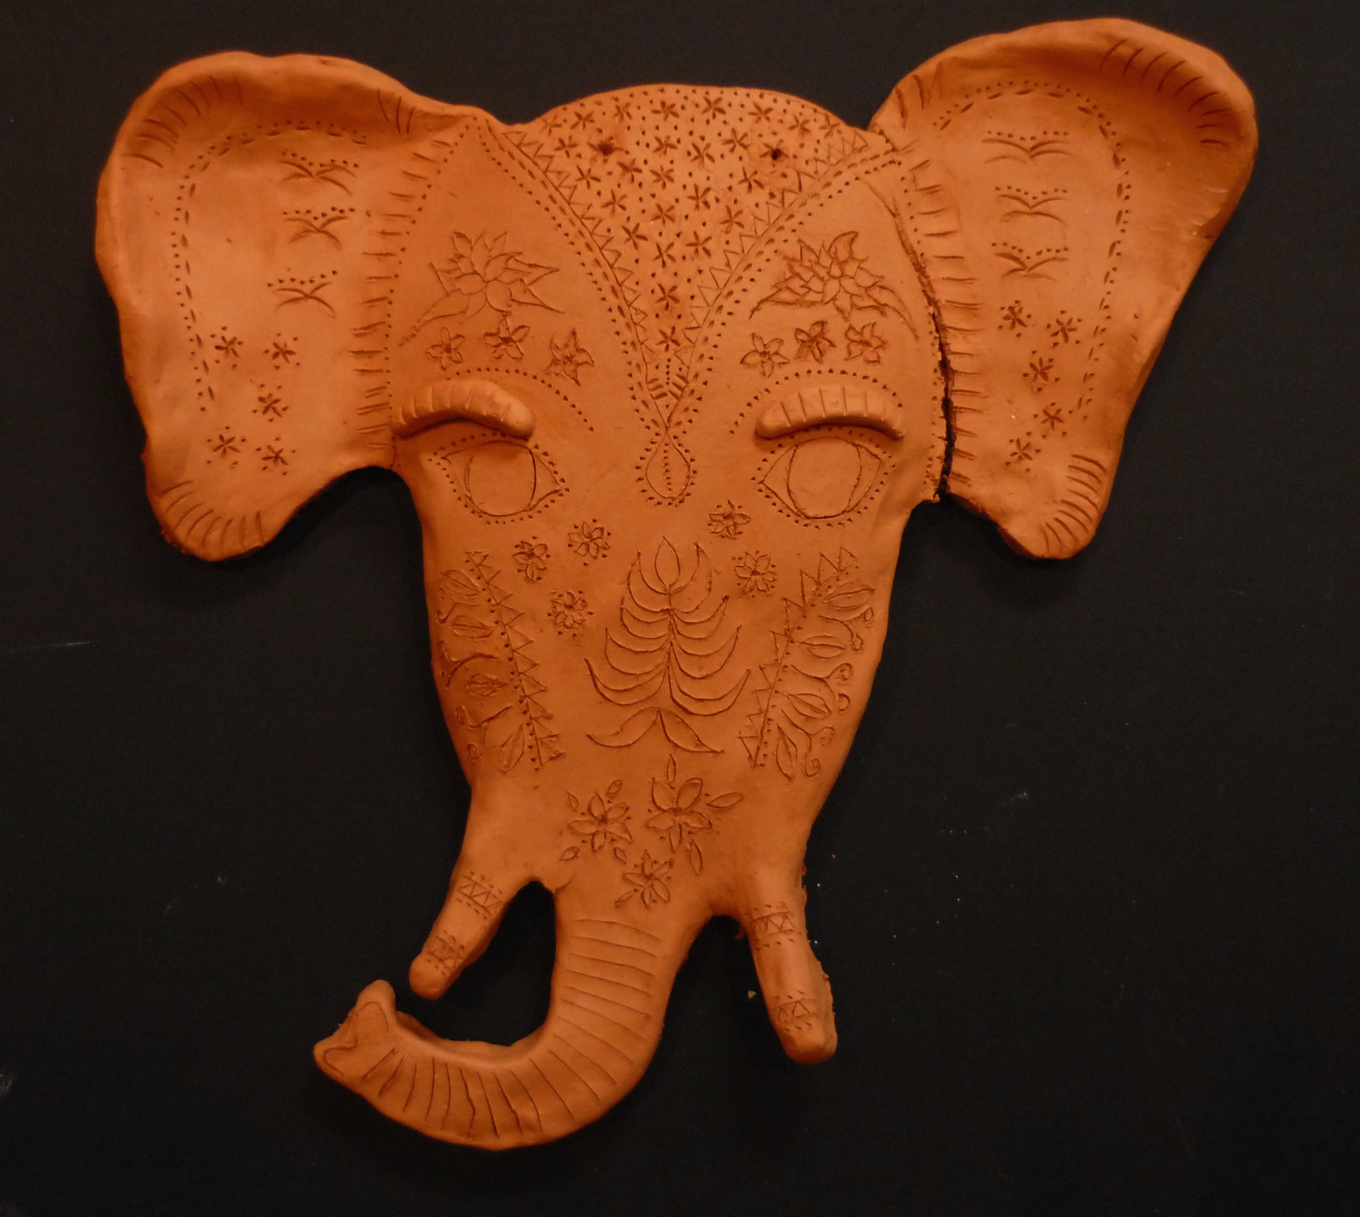

Slide 4
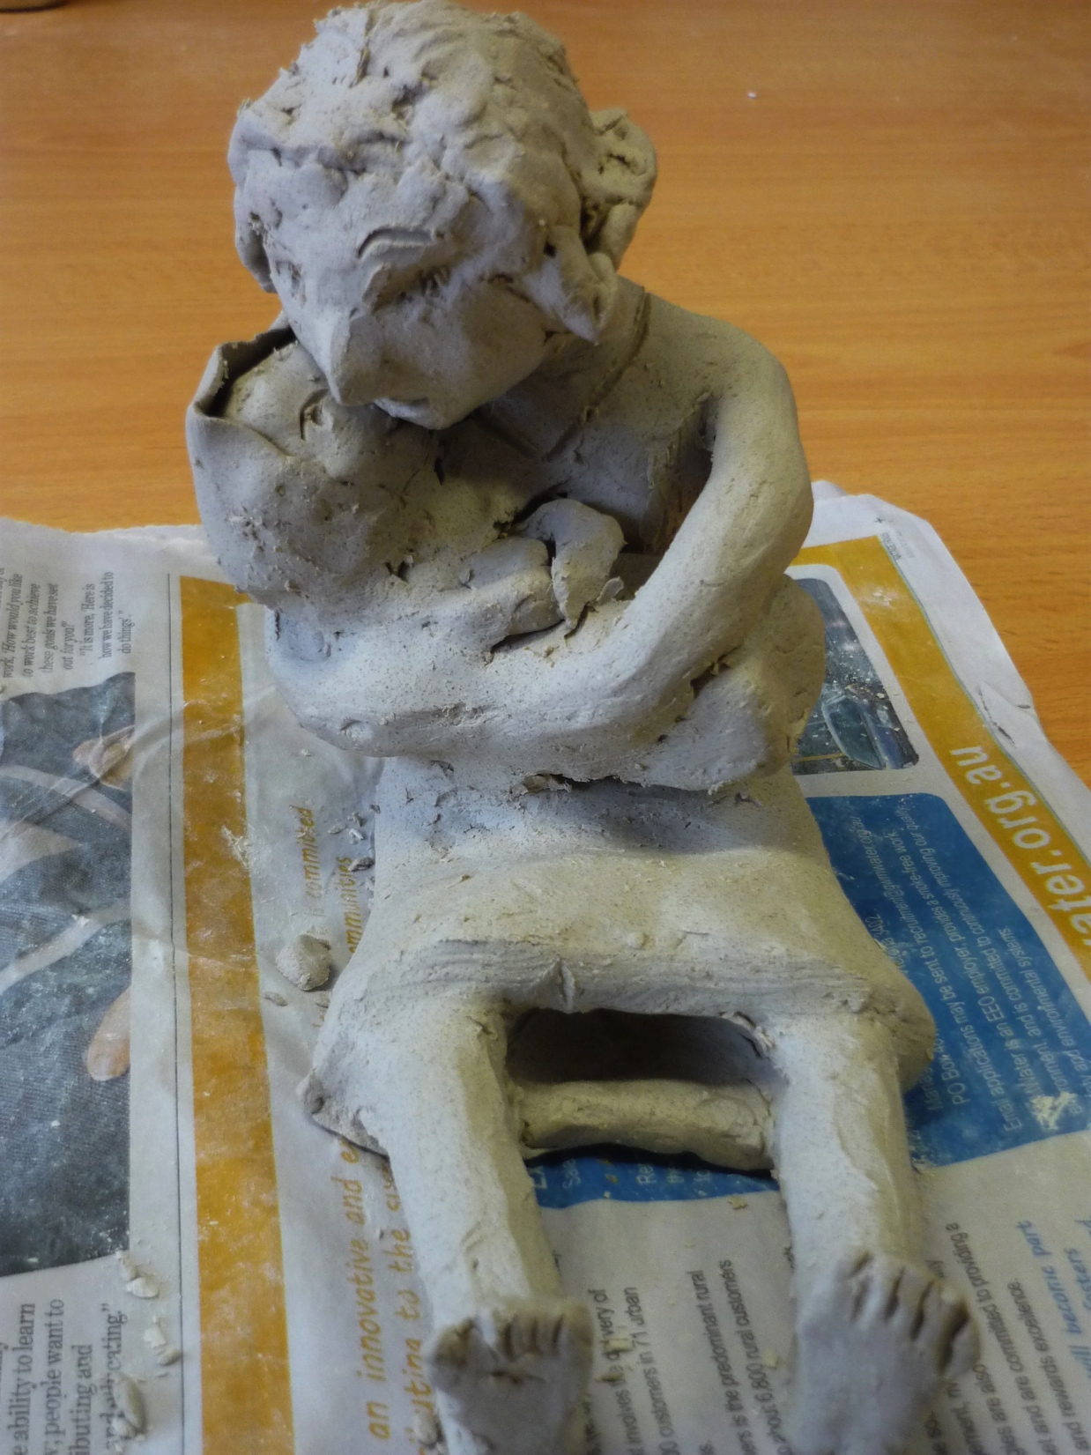

Slide 5
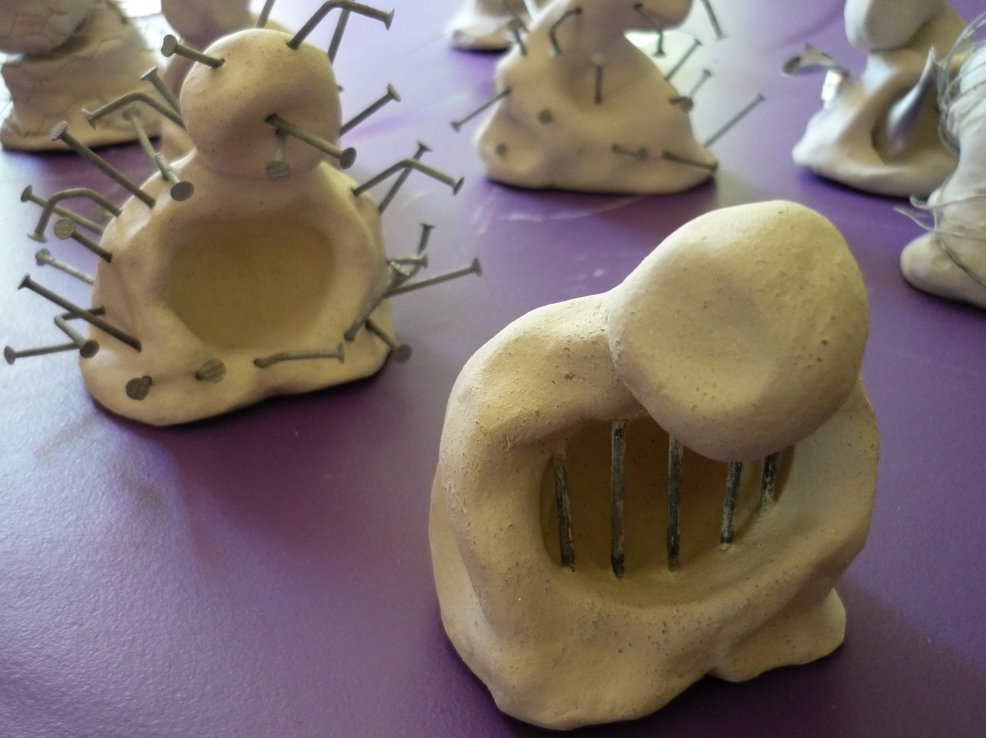

Slide 6
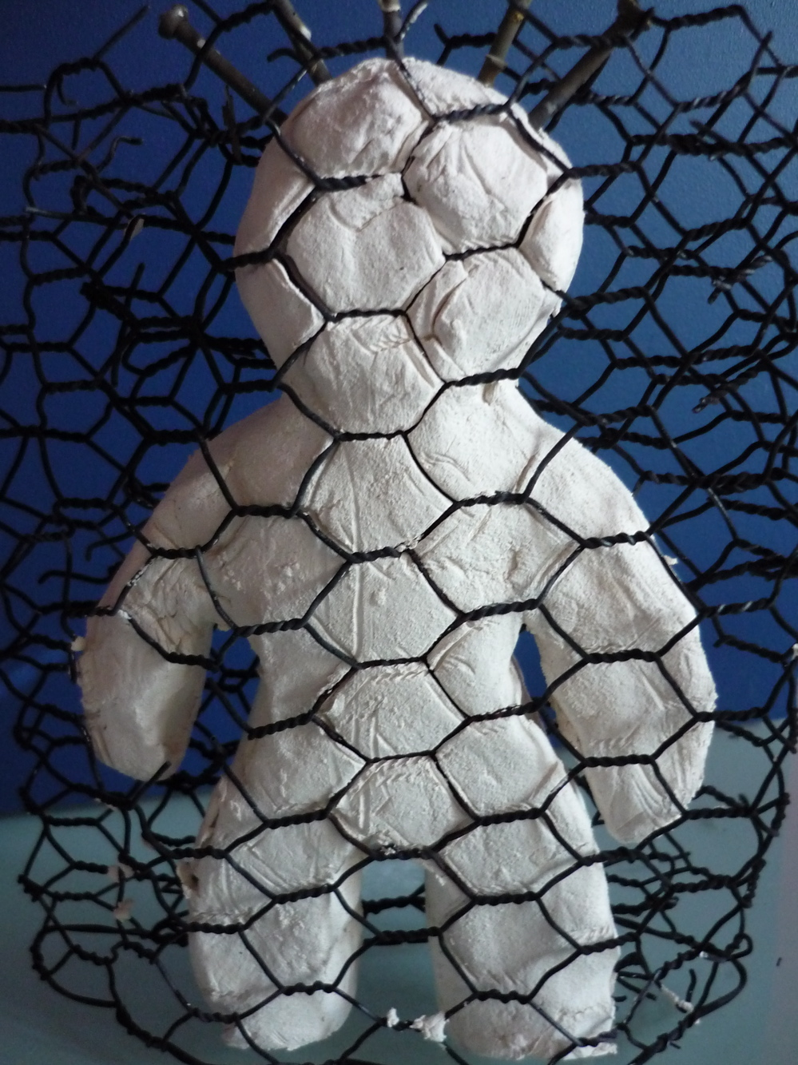

Slide 7
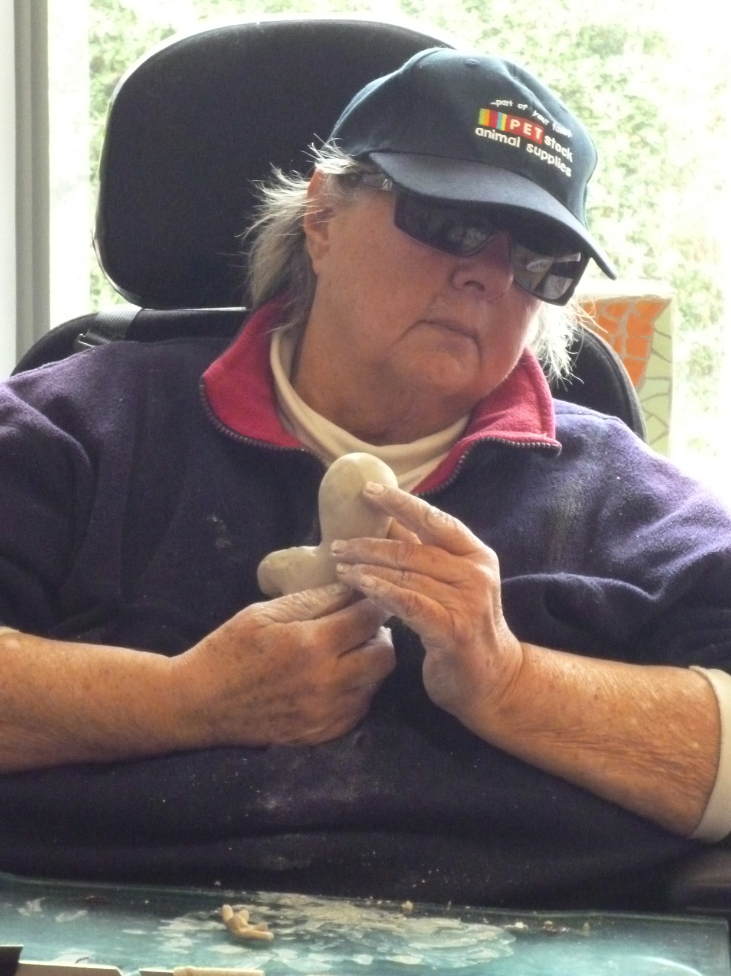

Slide 8
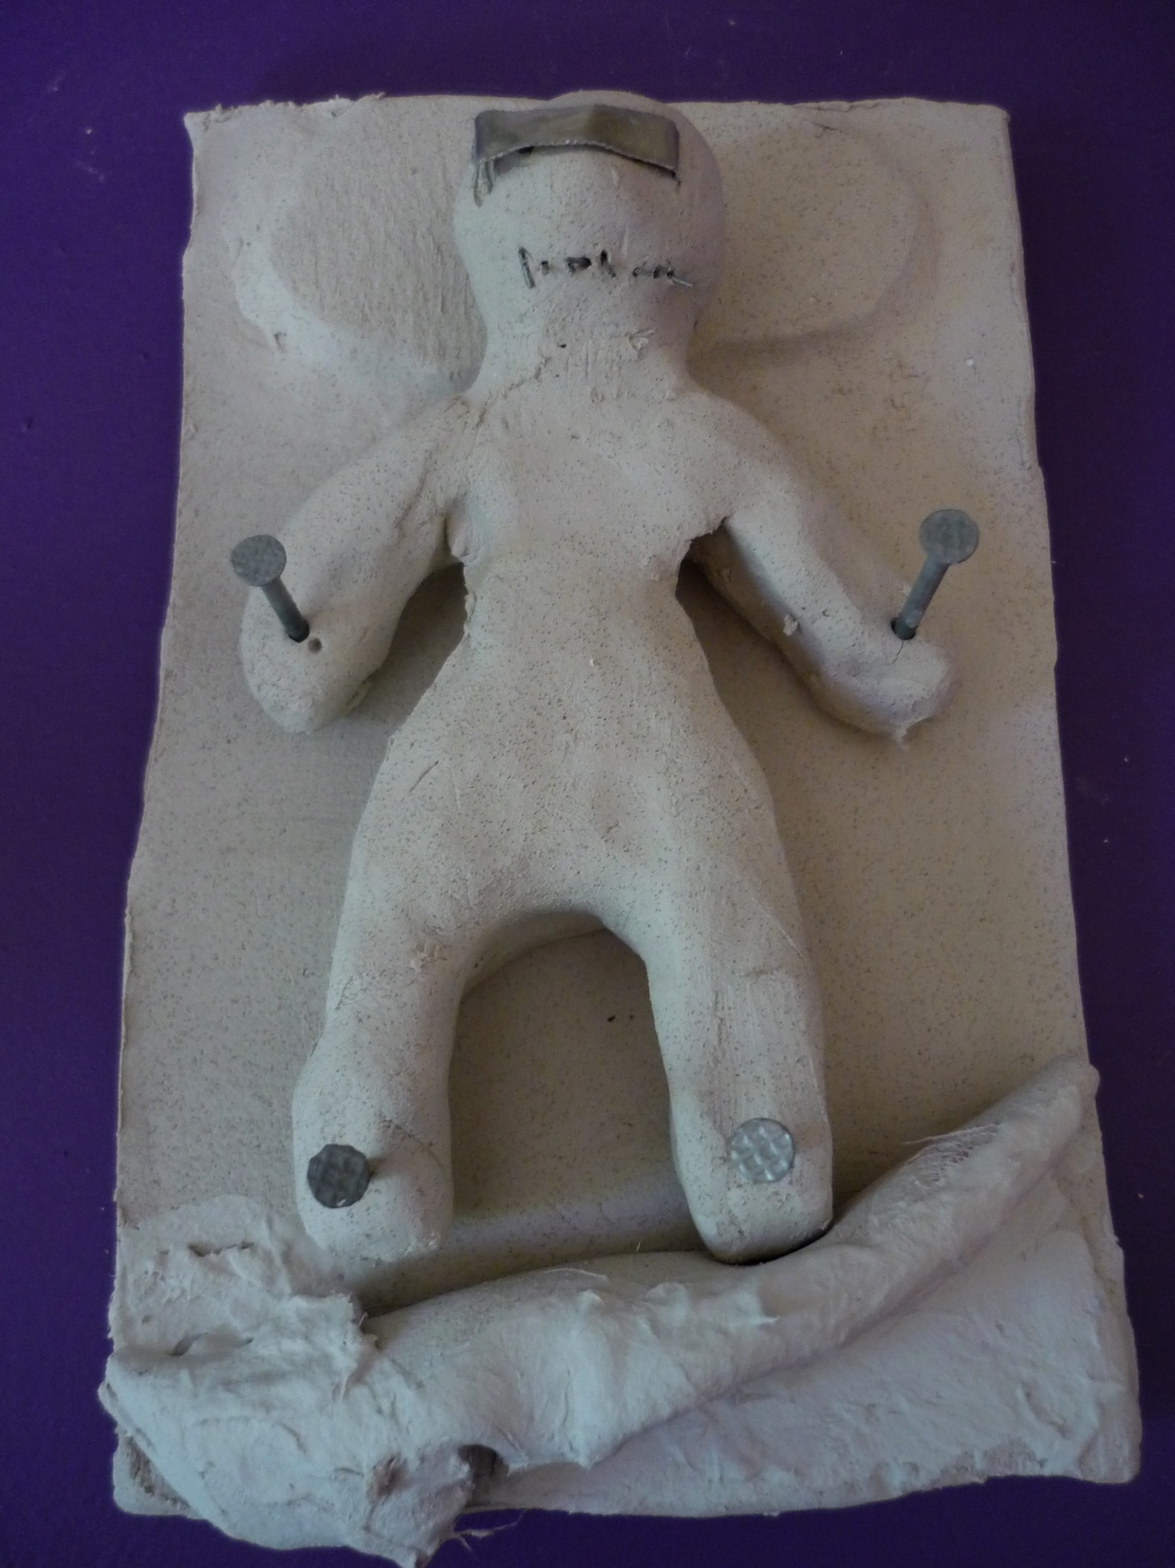

Slide 9
Un’not’ting
Releasing from negative self-talk
through creative practice

Slide 10
Un’knot’ting
Gaining insight to and release
from complex traumatic past through creative practice

Slide 11
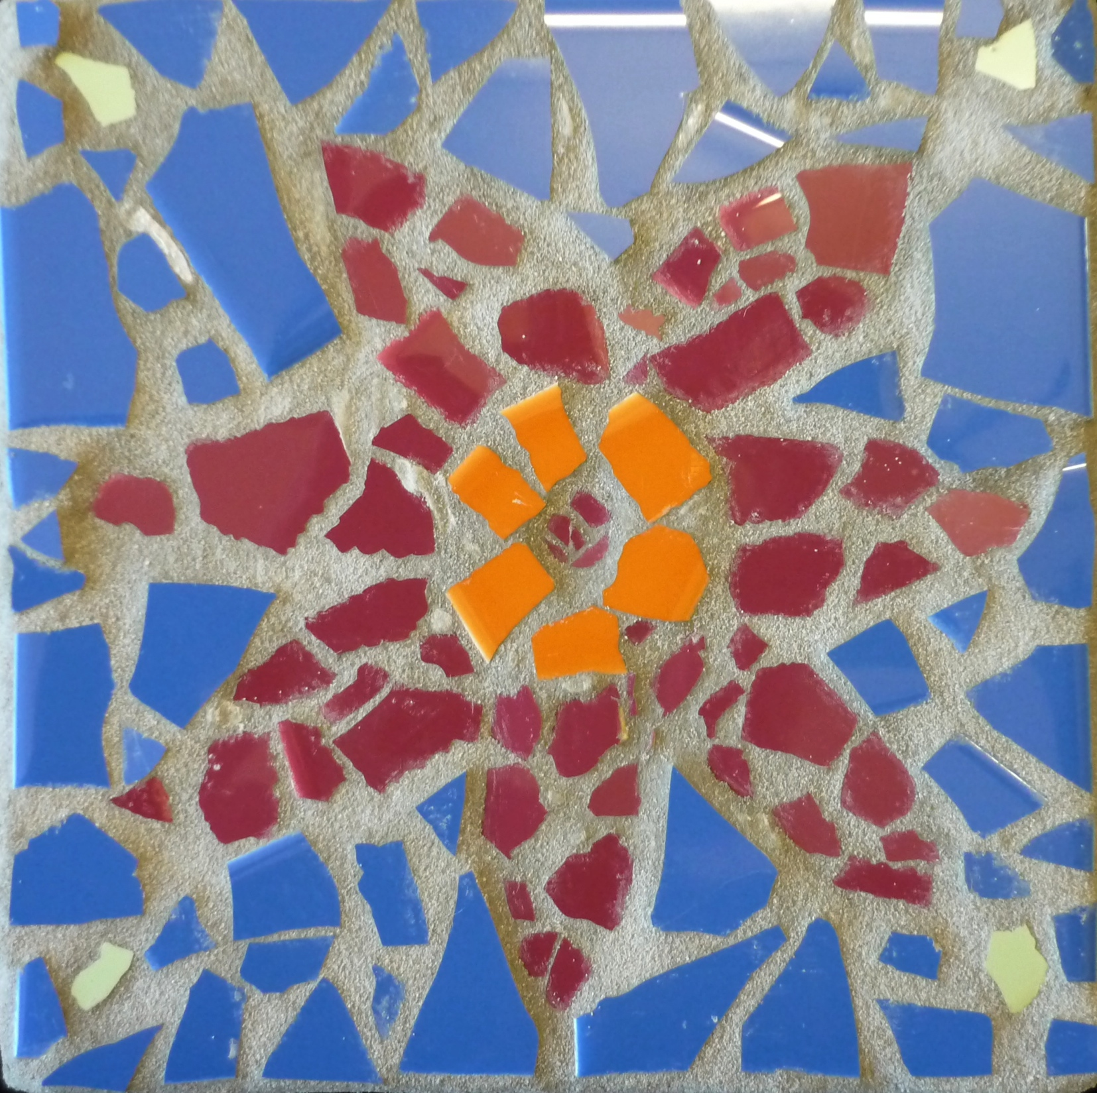
Week one : mosaic group

Slide 12
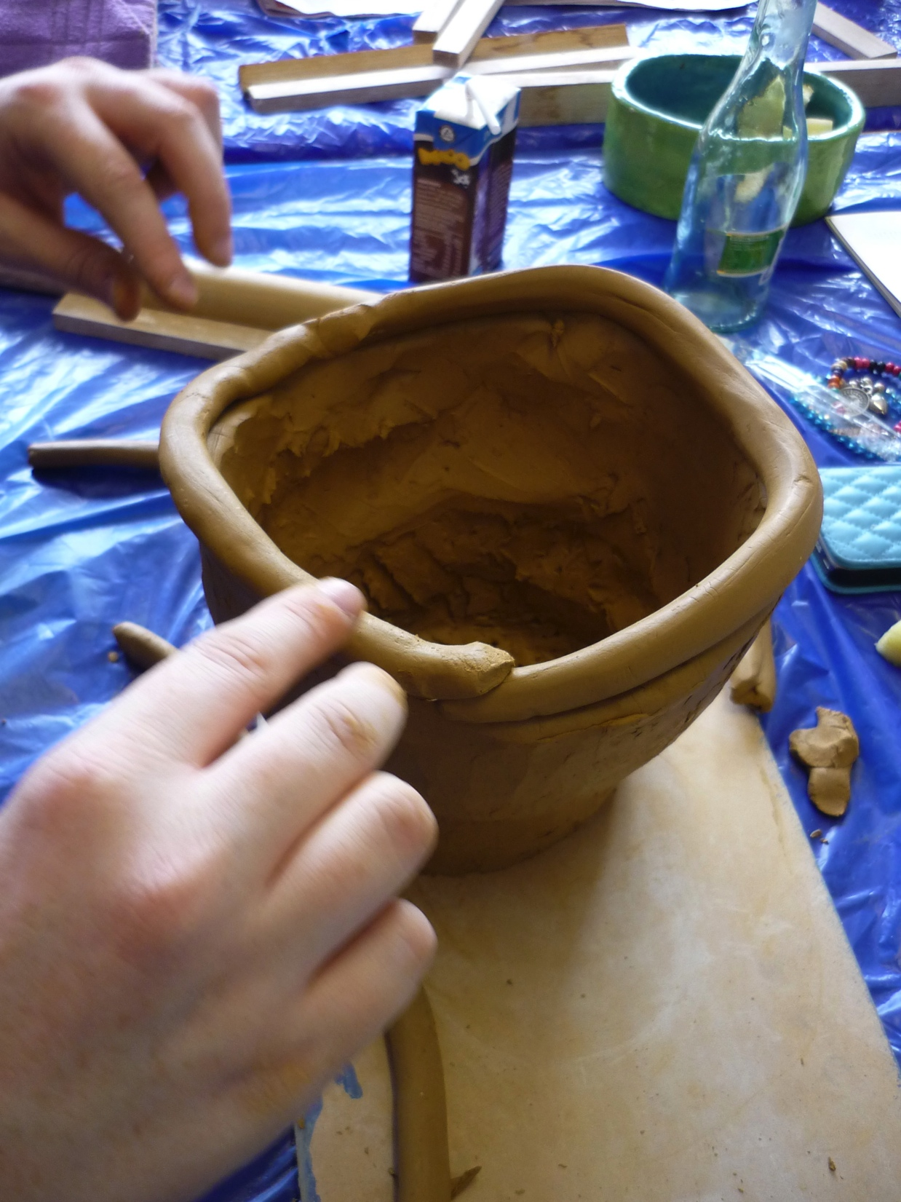
Starting with the basic skills of any art form builds a solid creative base

Slide 13
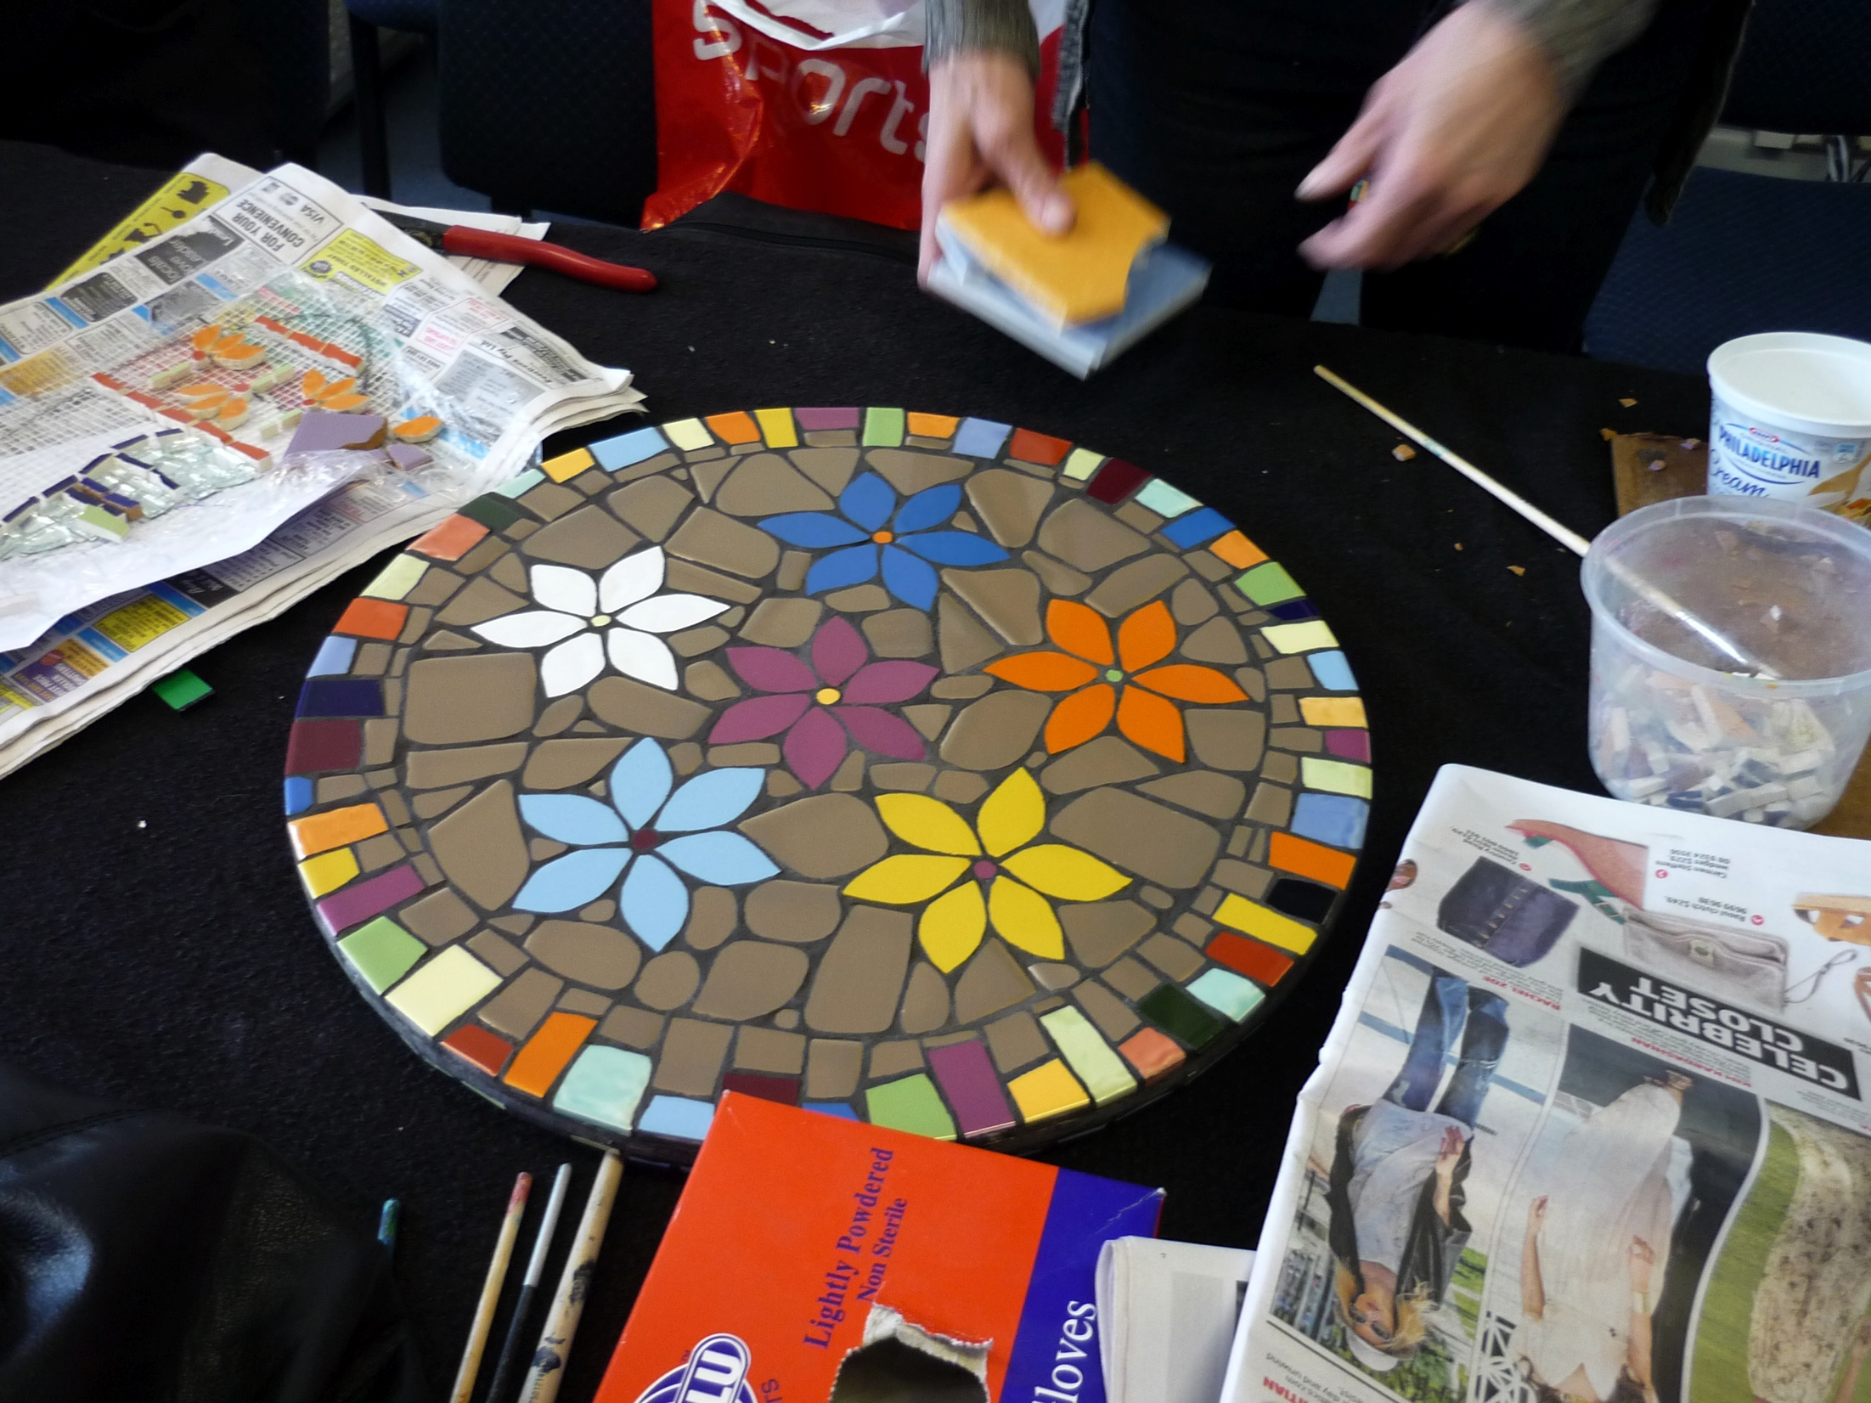

Slide 14
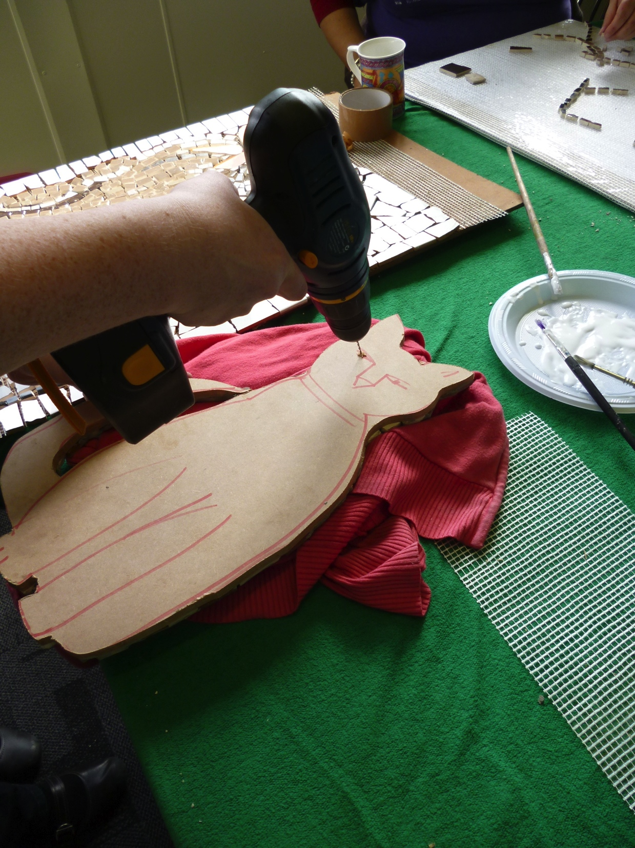
Learning to use tools builds
confidence and competence

Slide 15
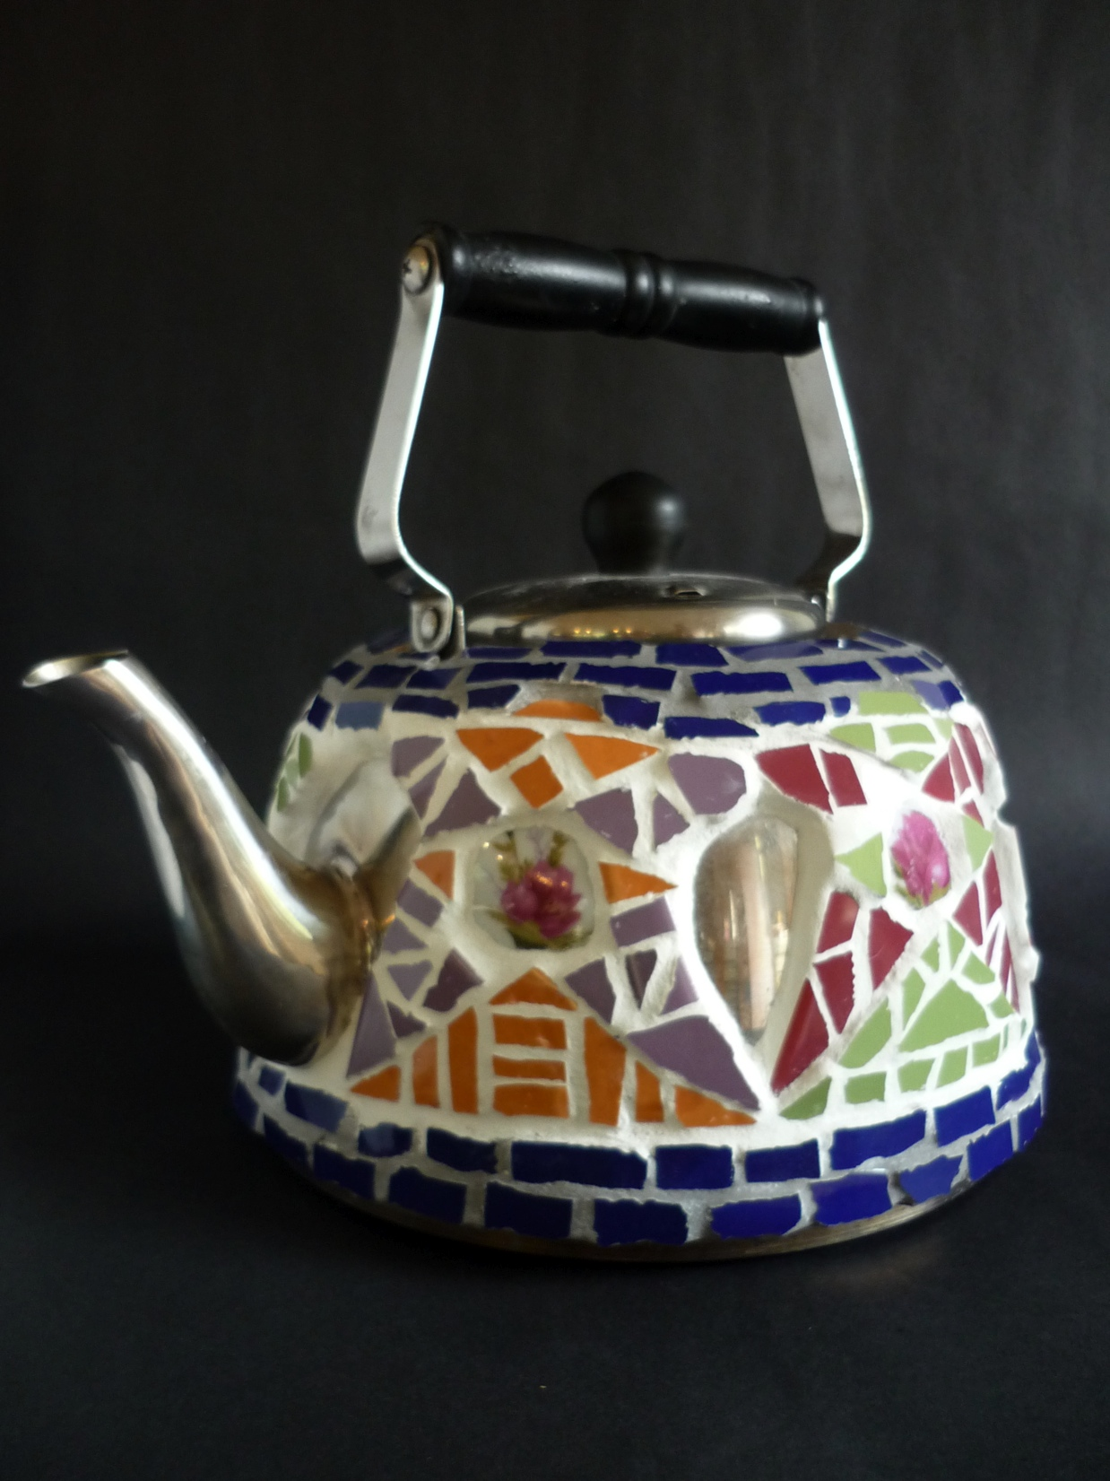
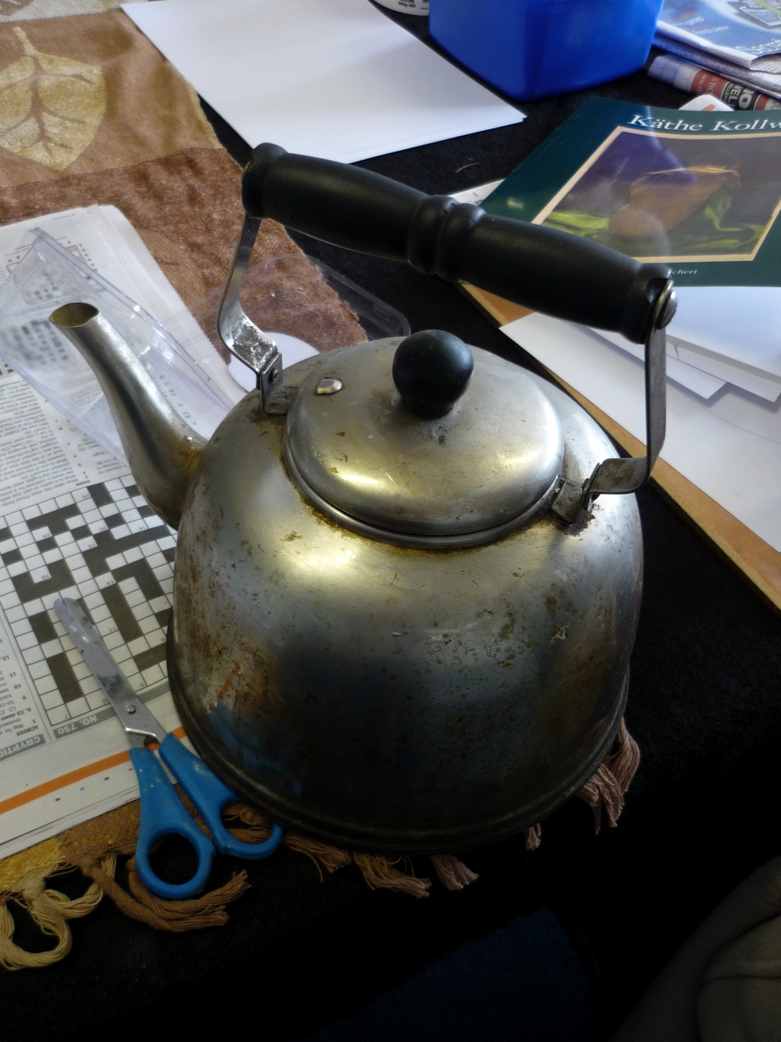
Using metaphor :
transforming discarded objects

Slide 16
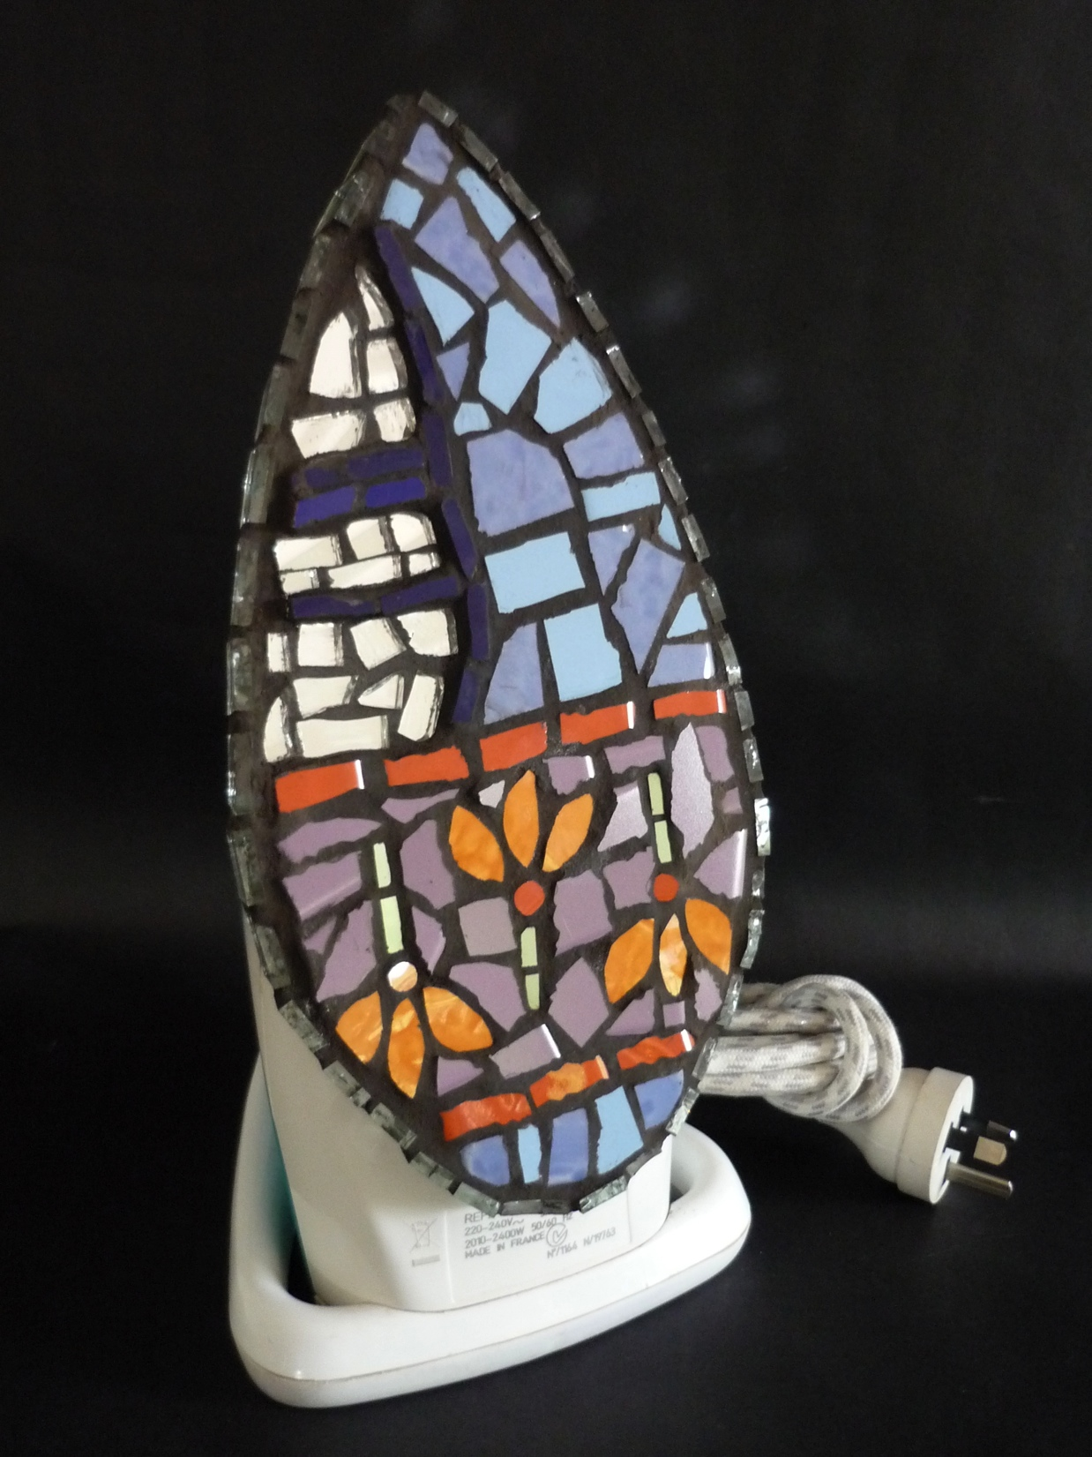

Slide 17
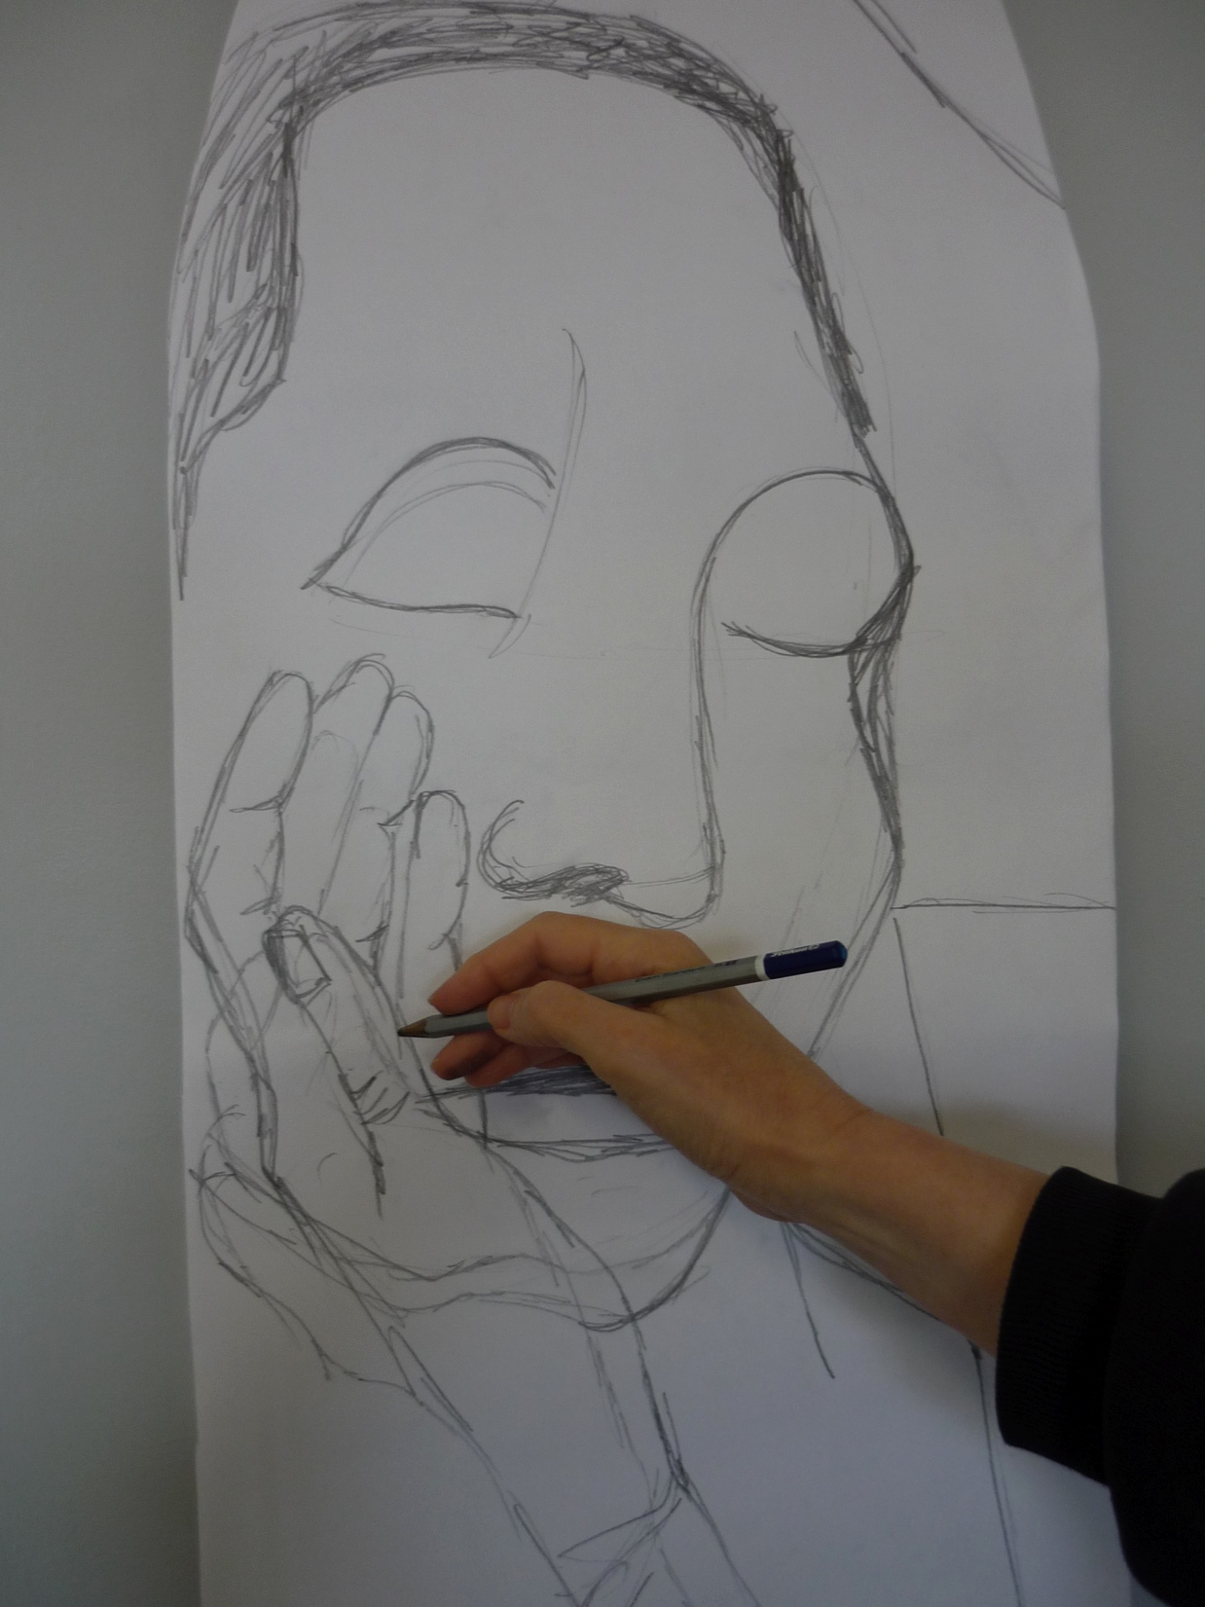
Students draw artists for inspiration: here German artist
Kathe Kollwitz

Slide 18
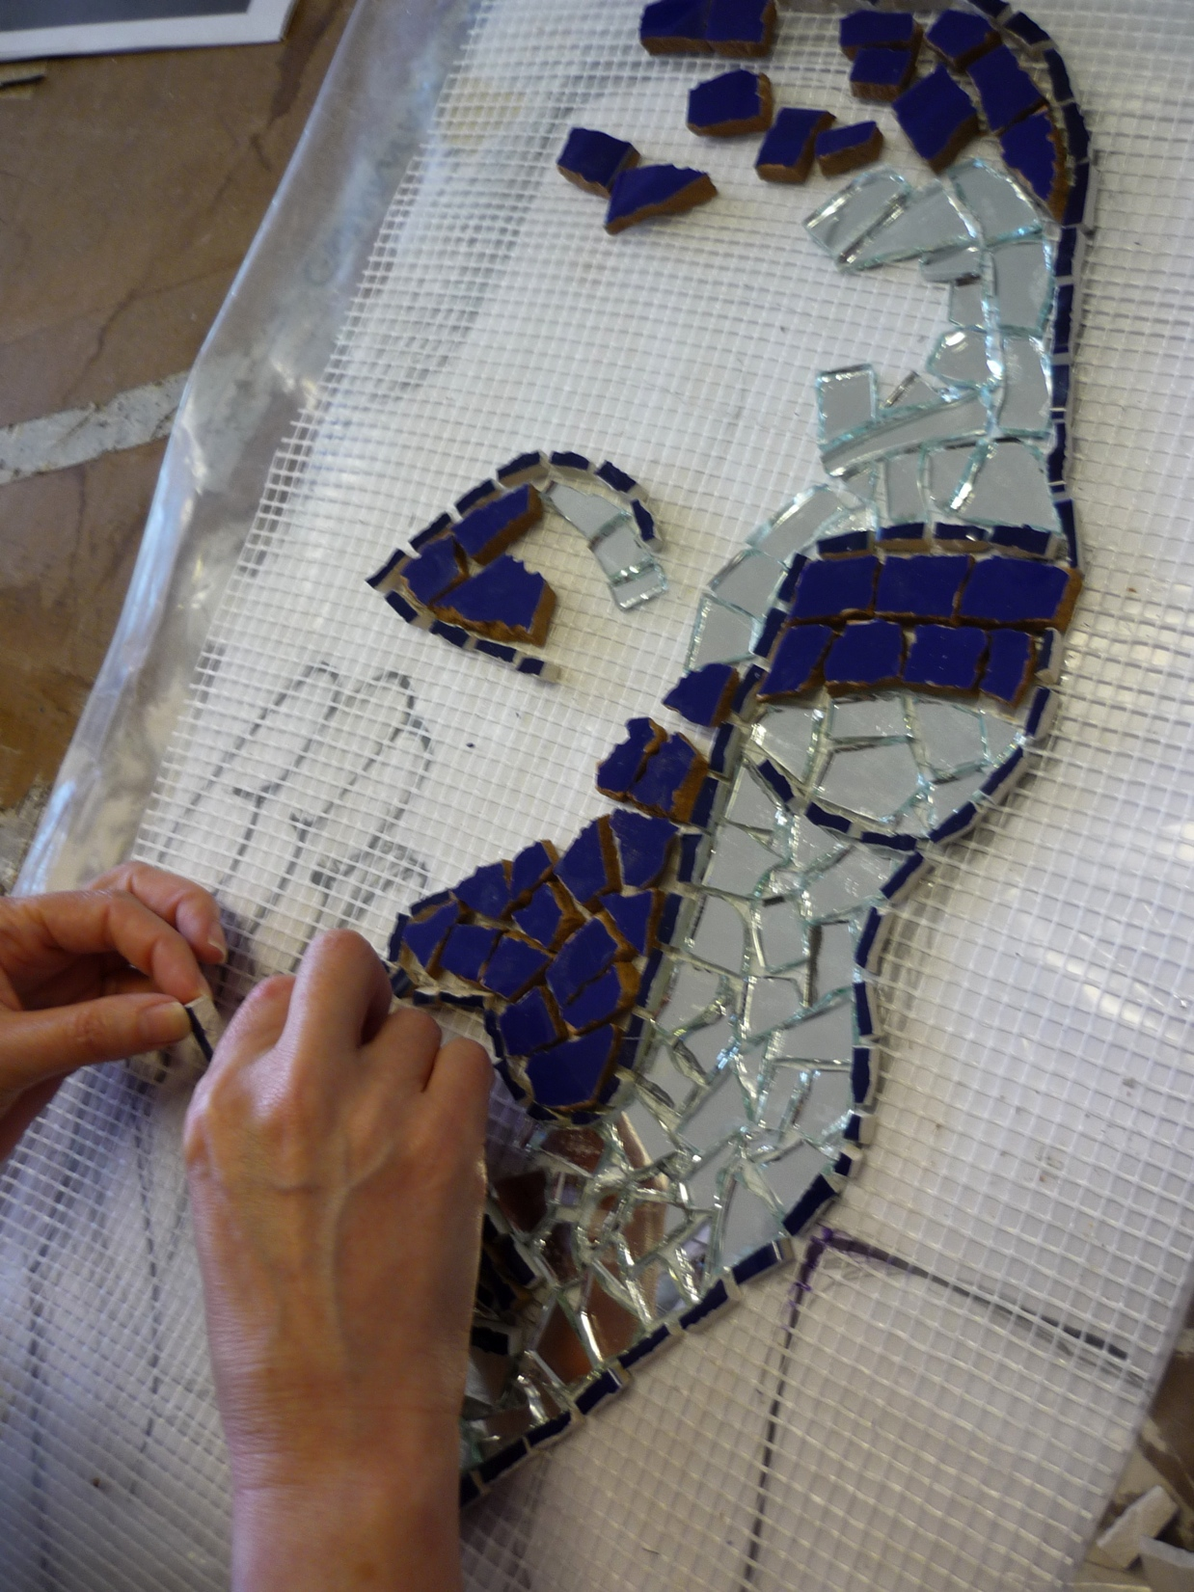
Group projects develop skills in negotiation, co-operation , compromise as well as being fun and inspiring.

Slide 19
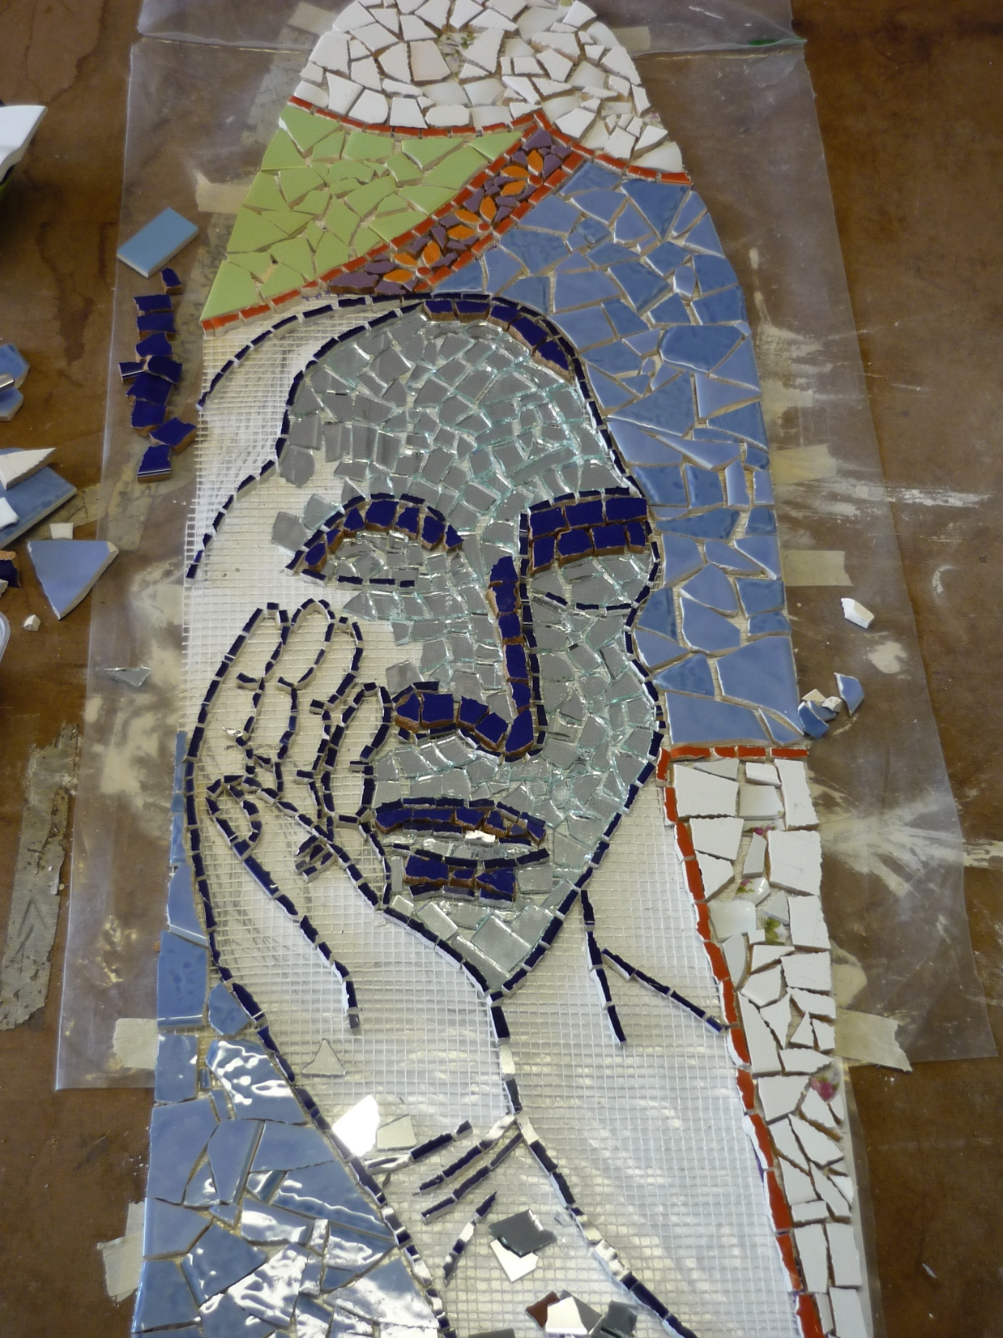

Slide 20
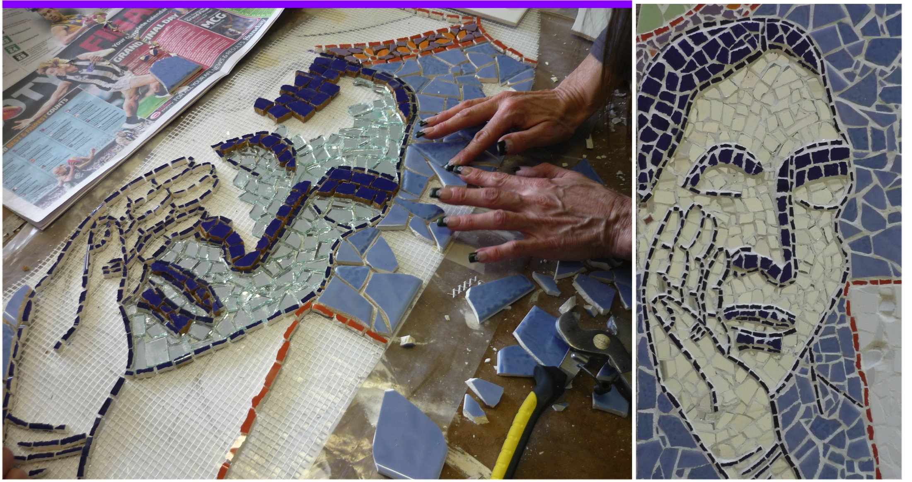
This group project opened women to acknowledging that receiving care is possible and welcome.

Slide 21
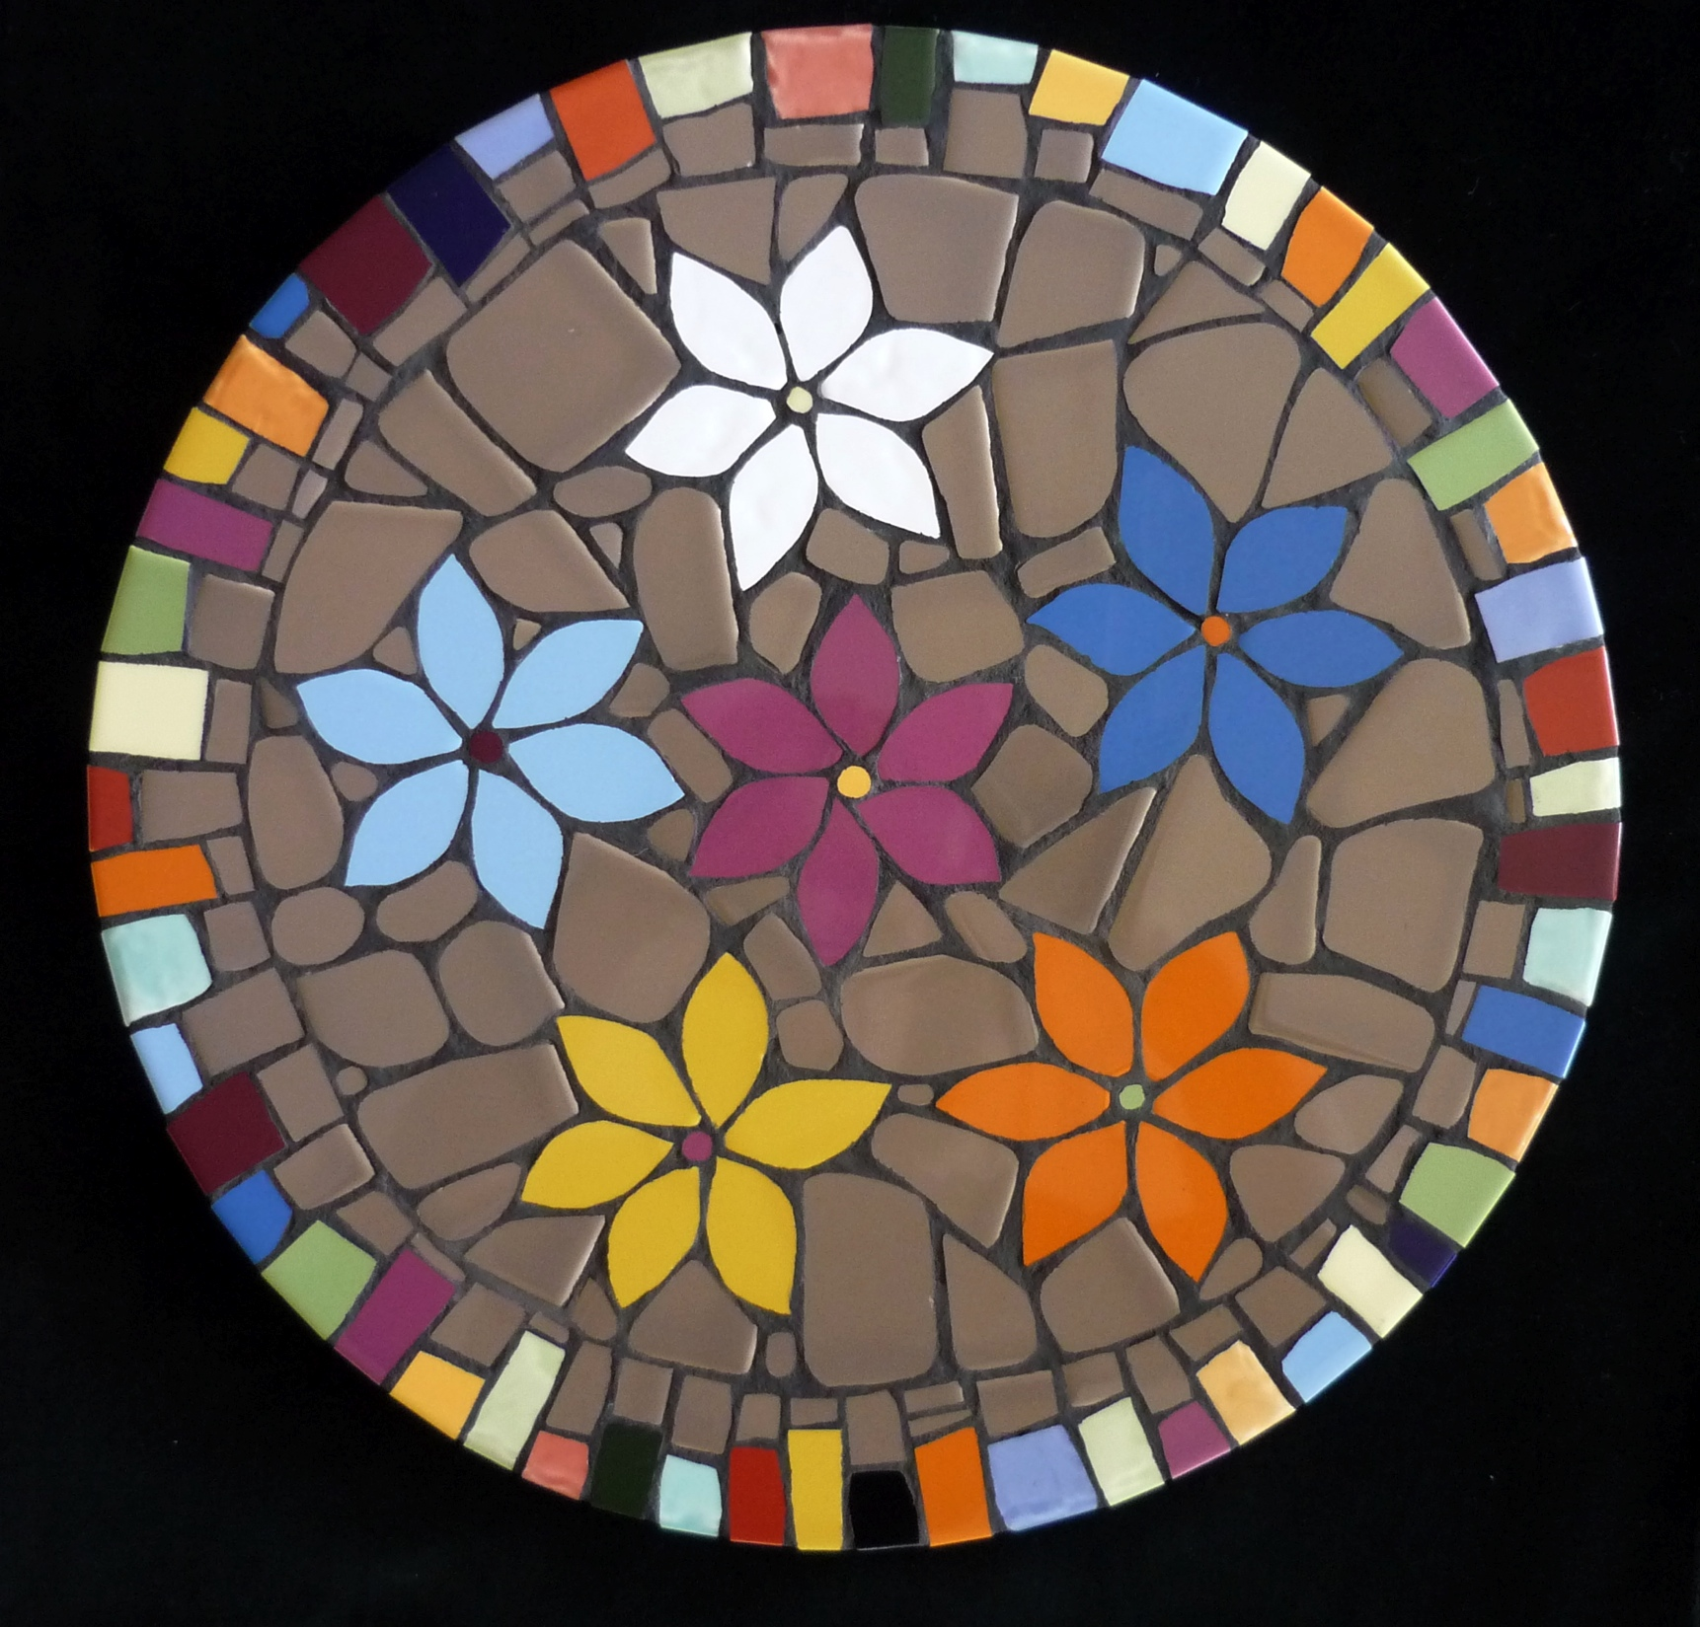

Slide 22
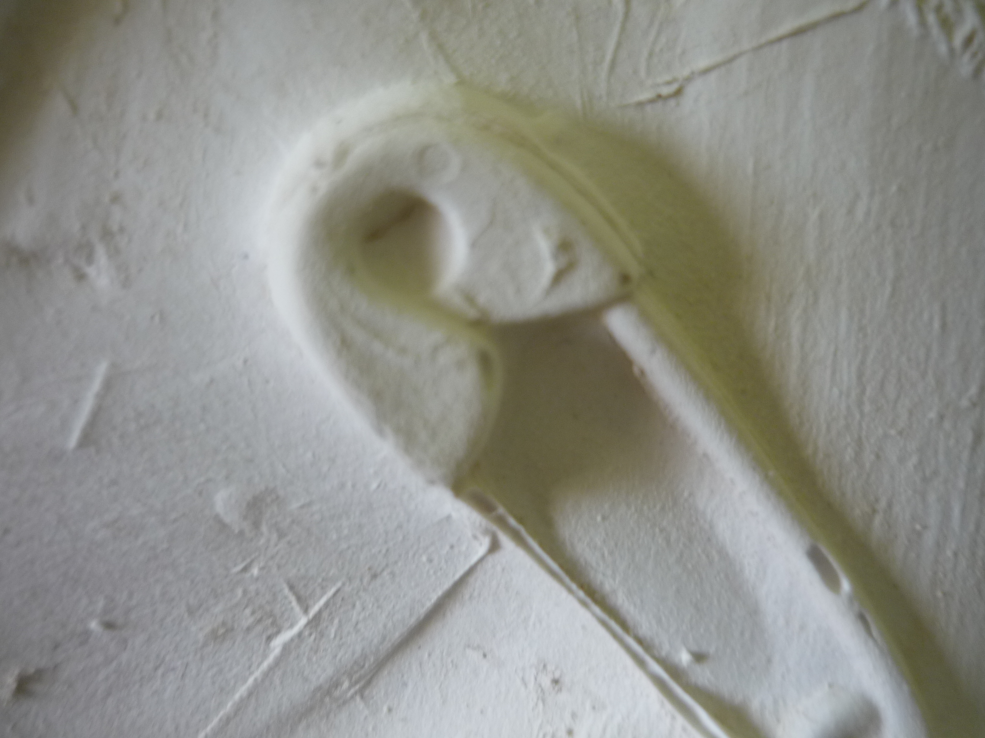
Art and casting techniques give form to memories that are difficult to name and express in words.

Slide 23
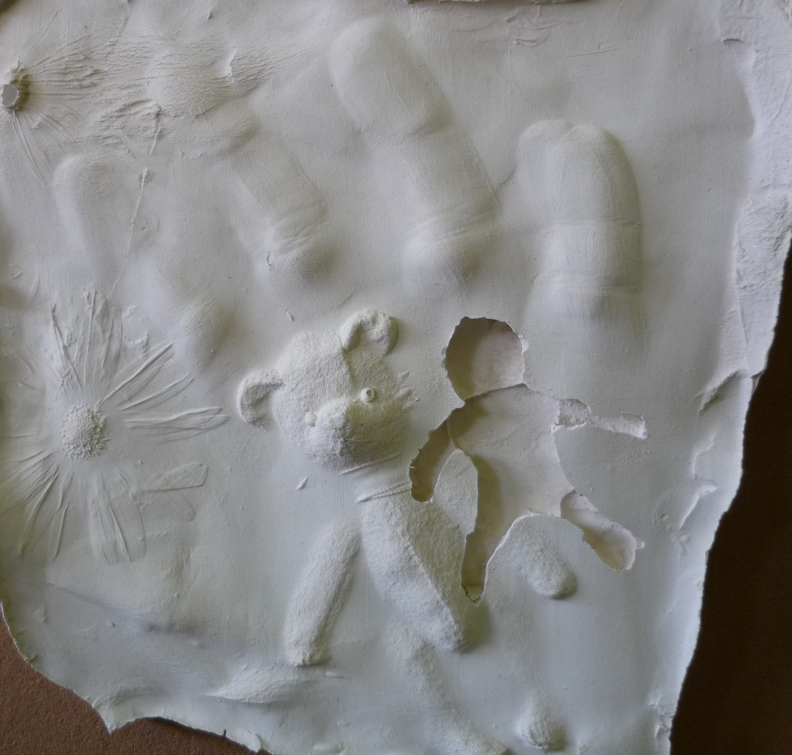

Slide 24
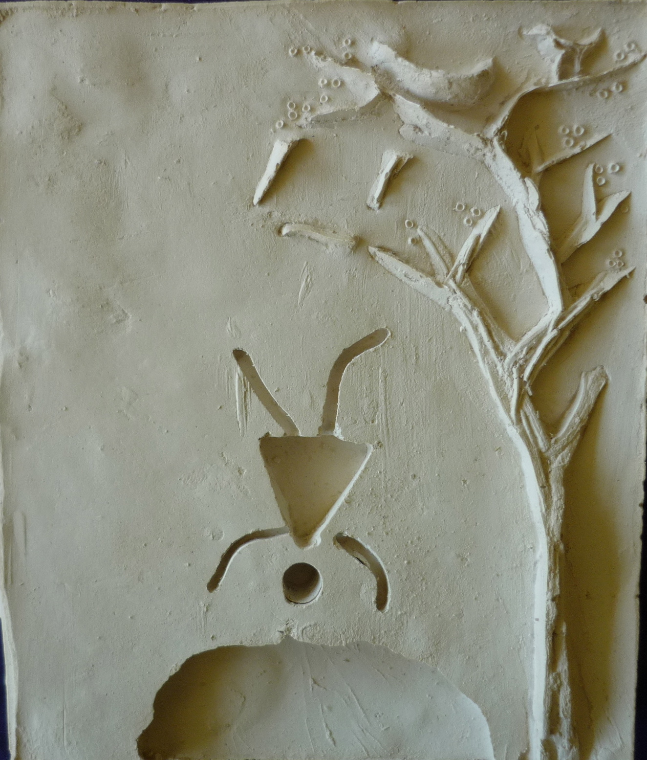

Slide 25
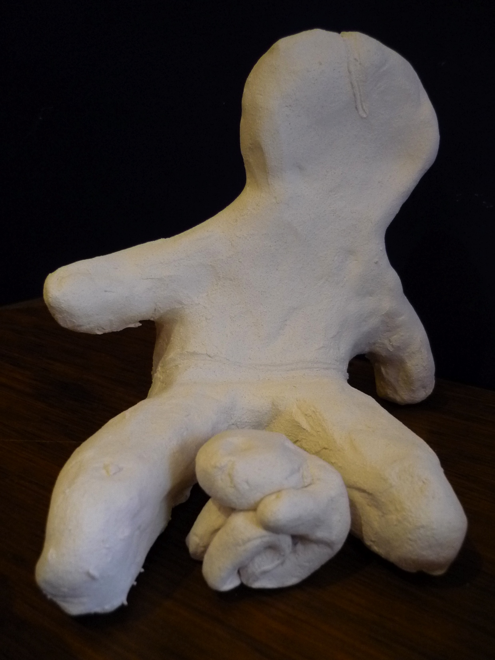

Slide 26
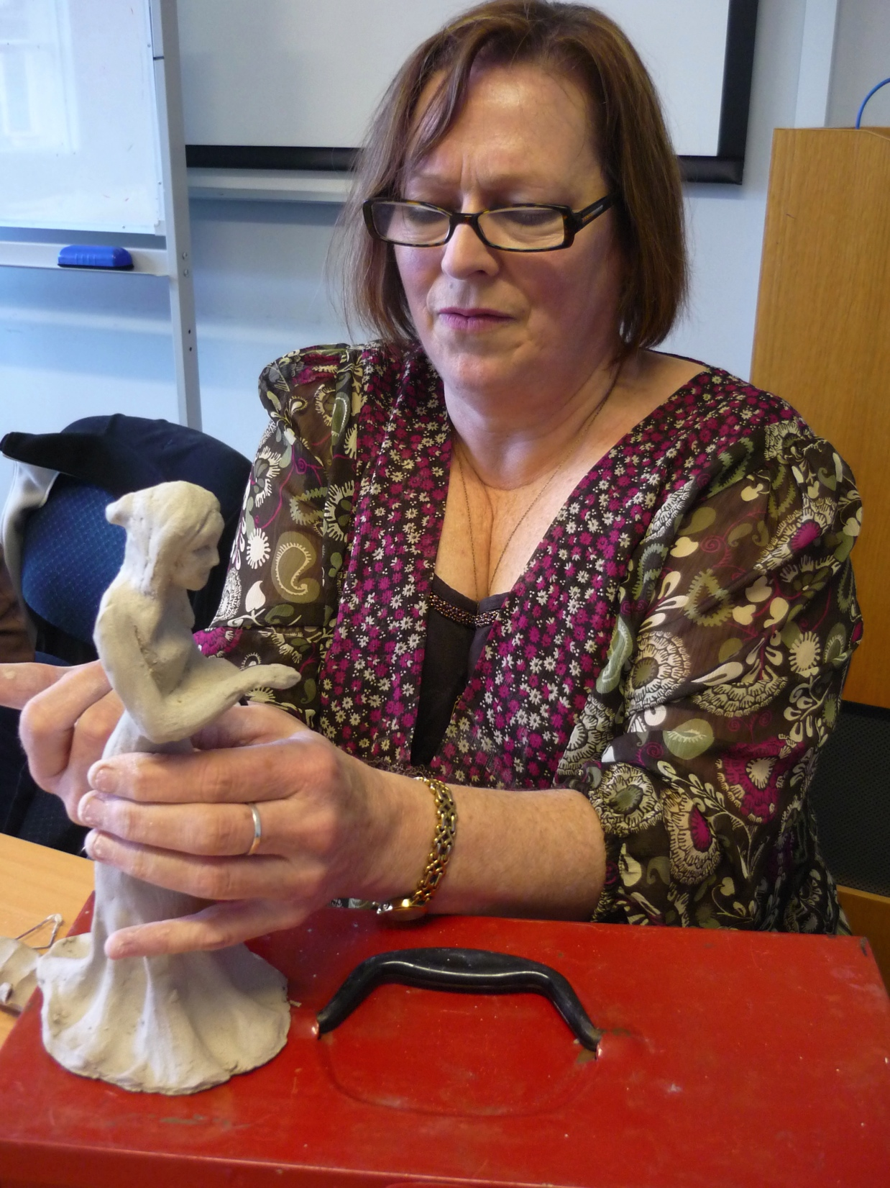
Participants gain skills in focussing and maintaining concentration

Slide 27
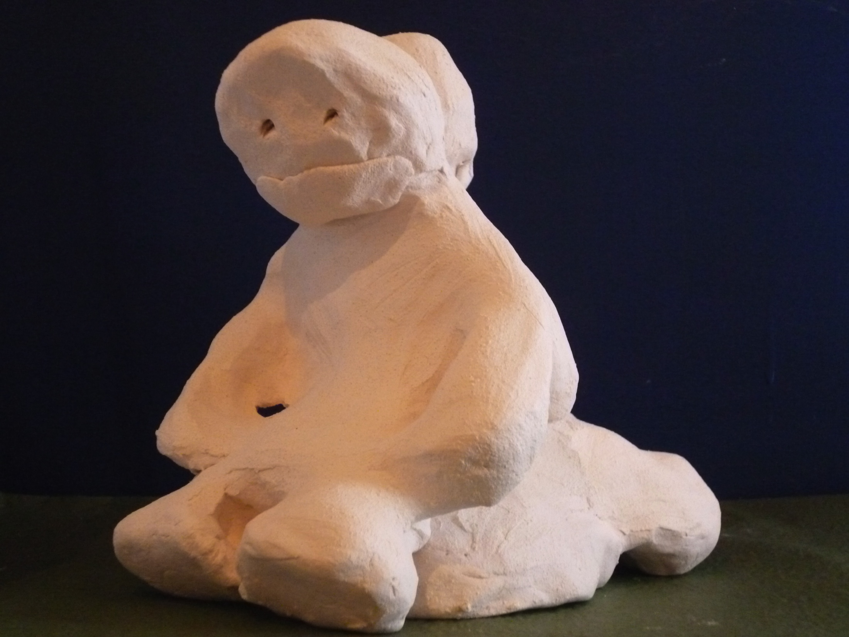

Slide 28
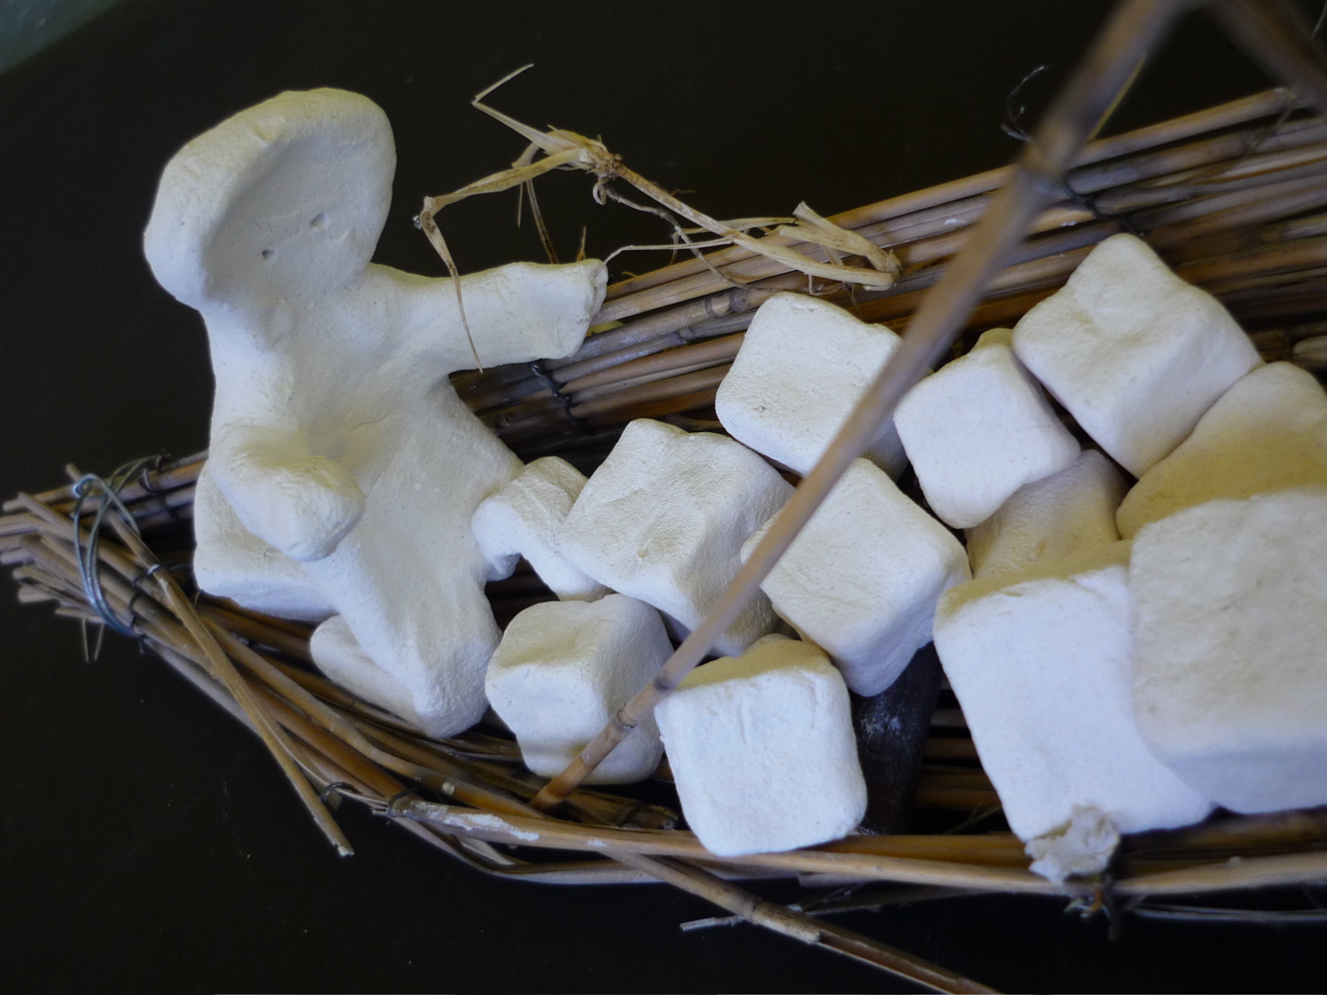

Slide 29
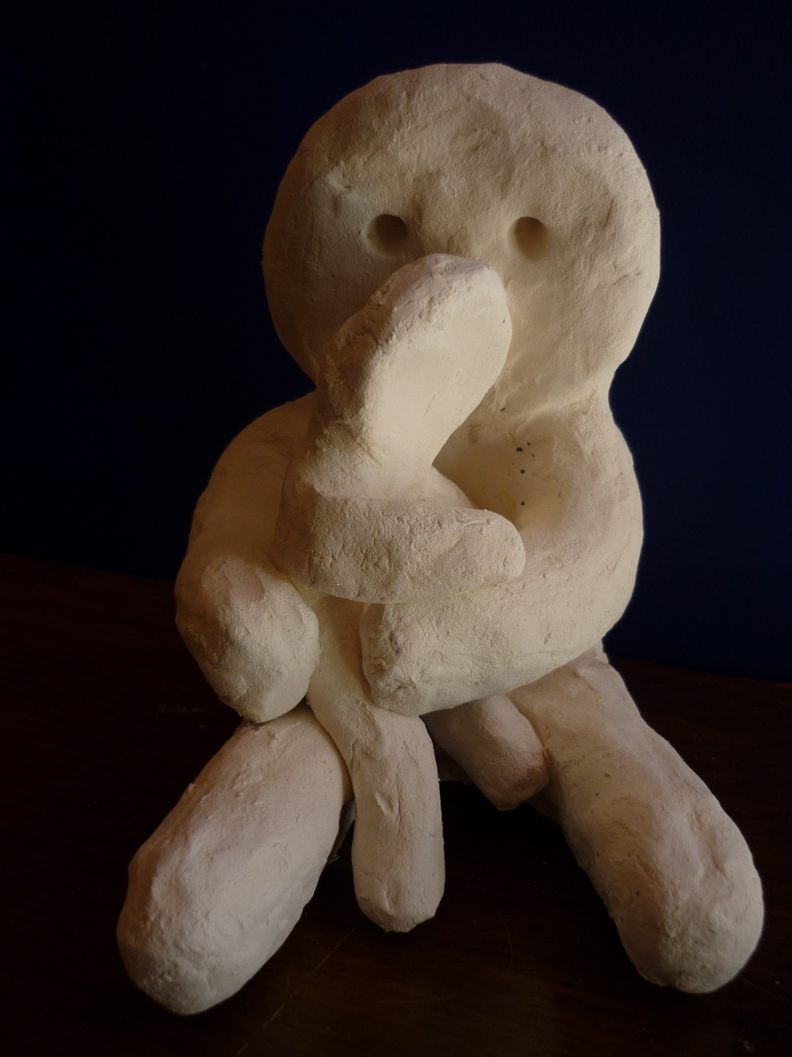

Slide 30
Long term benefits
Arts practice becomes part of life : studio spaces established, new groups form
Friendships established and maintained
Higher education undertaken
Return to or join the workforce
Better and sustained family/personal relationships
More pleasure in life
More participation in community life
Reduced need for therapy
Develop broader interests

Slide 31
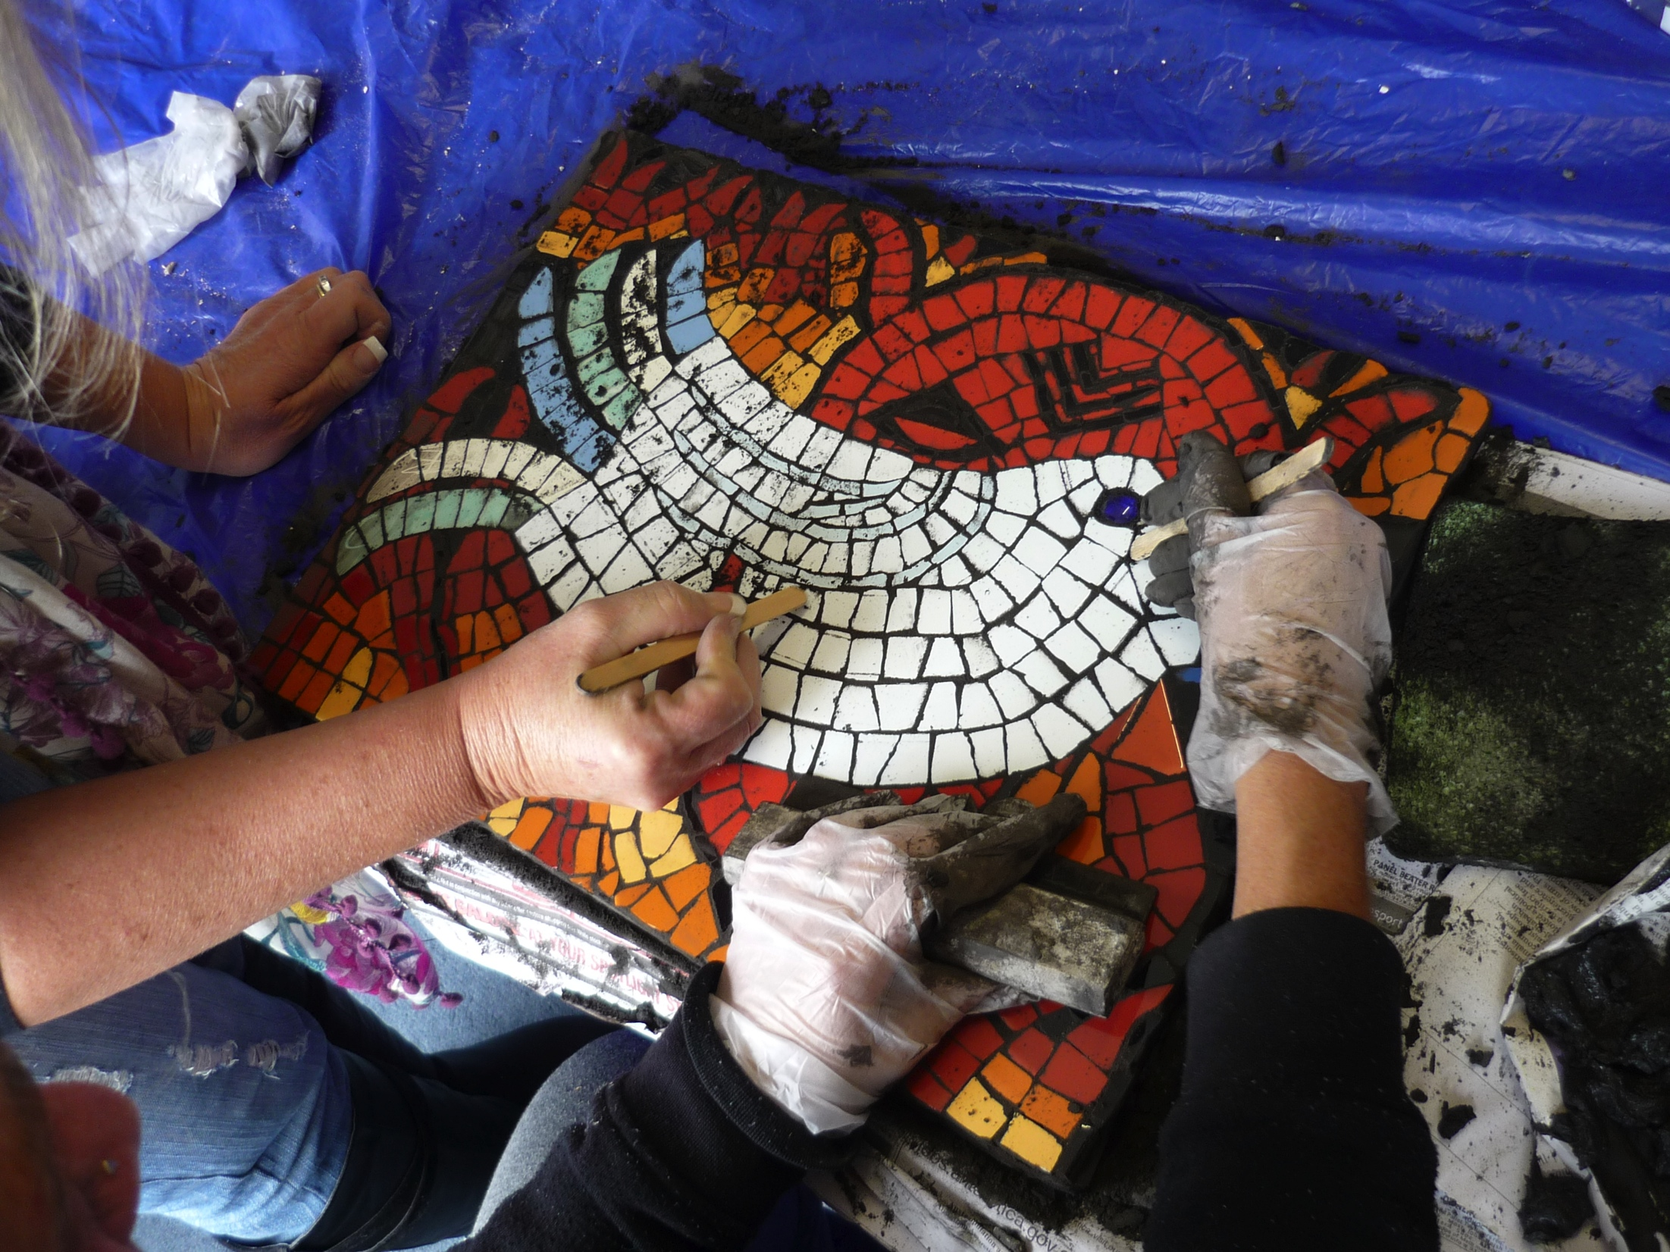
Helping each other builds community

Slide 32
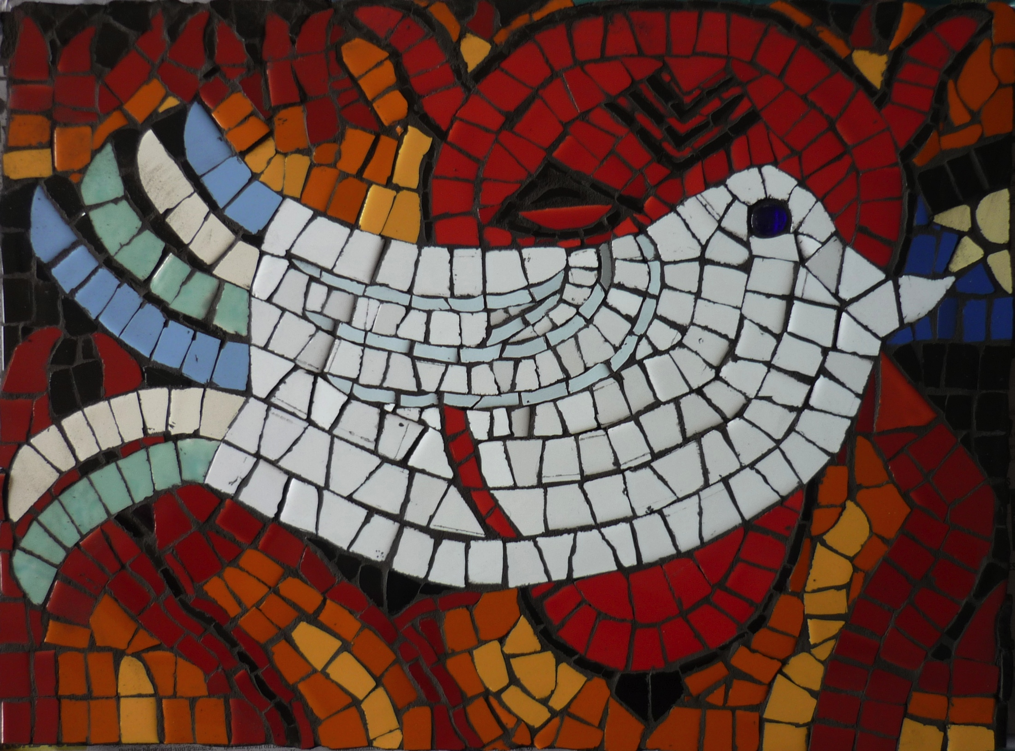

Slide 33
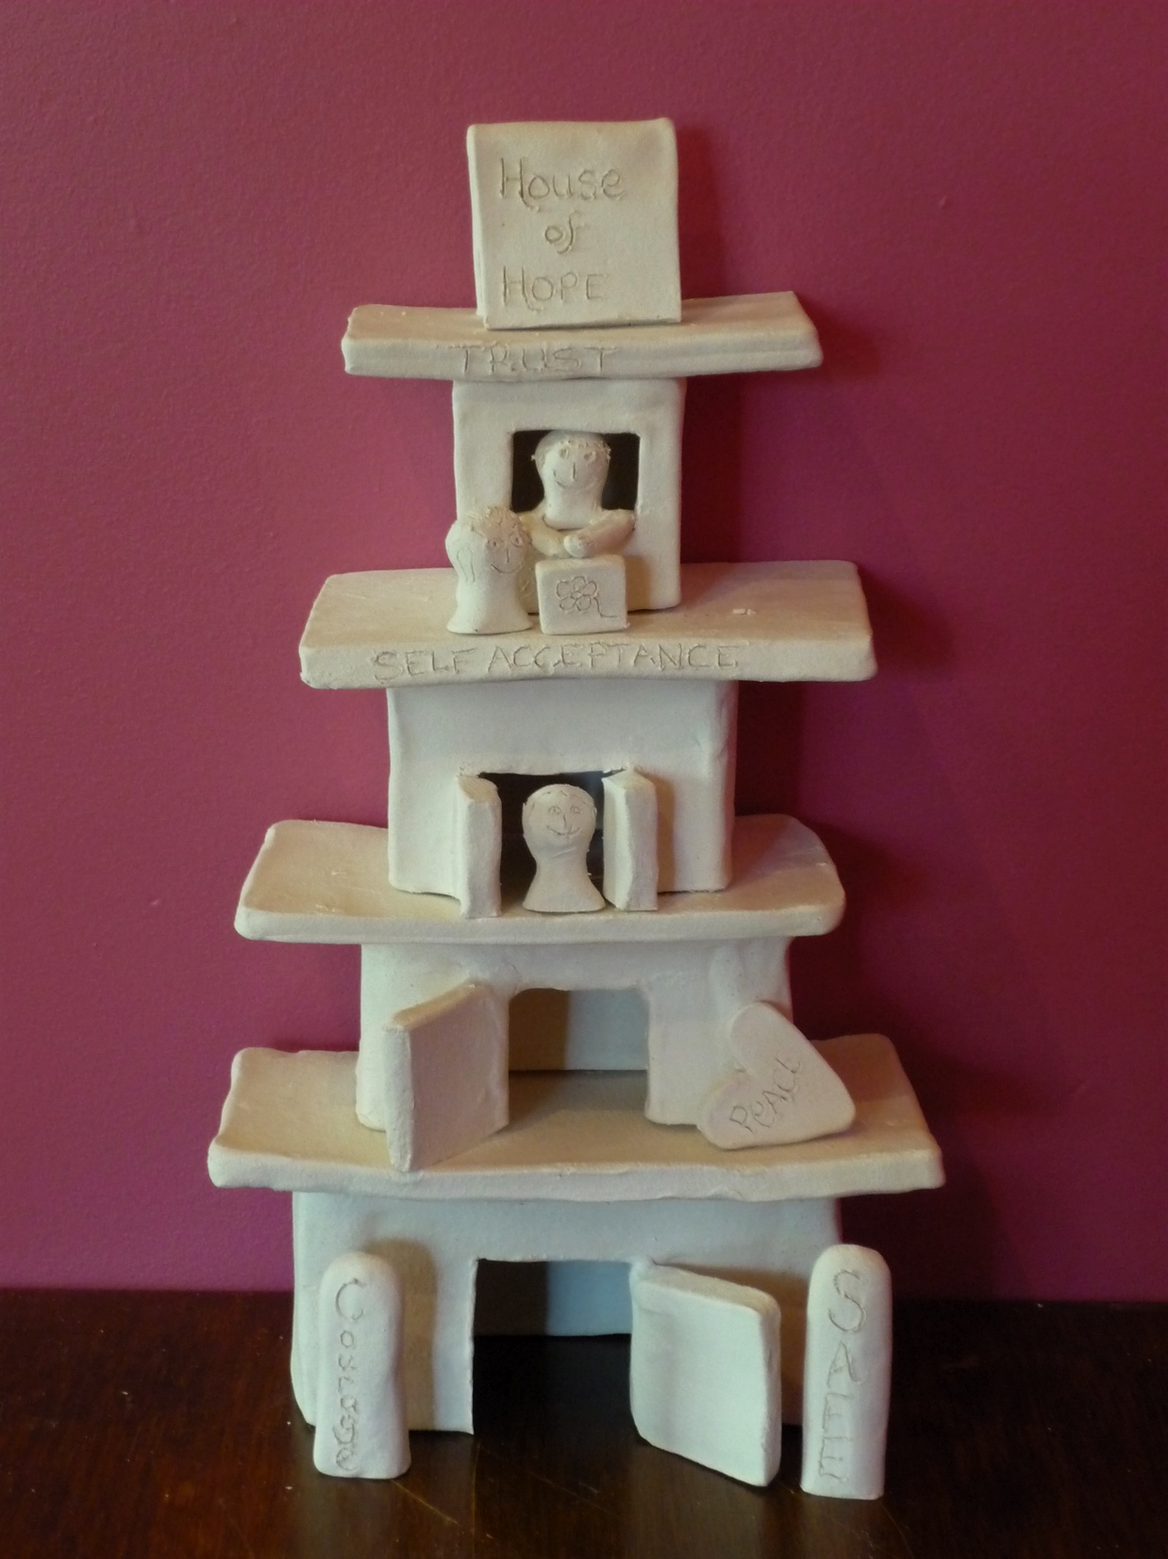

Slide 34
Anne Riggs
PhD artist
Artists in Community International
www.anneriggs.com
ariggs@alphalink.com.au

